Slide 1
Semantic and Internalist Justifications of Kant’s Attack on Intuition
Henry Fernando
University of Cambridge
4 October 2025

Slide 2
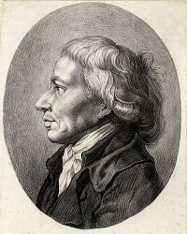
Background: Schlosser
Johann Georg Schlosser (1739-1799) was a public official, jurist, and amateur scholar who published the first German translation of Plato’s letters (1795).
Plato’s Seventh Letter recounts and justifies his journey to Syracuse to engage with a tyrannical regime in Sicily and to advise his disciple Dion, the tyrant of Syracuse, to bring about a greater good than Athenian democracy.
Schlosser sympathized with Plato and warns his readers to be wary of “freedom preachers” who used violence in the name of liberty.
Recall: Europe was still reeling from the French Revolution and the Jacobin Reign of Terror.
Schlosser’s view was that the traditional social and political order is justified by divine right, and that ancient philosophers like Plato were correct to speak of certain individuals having a right to rule due to possessing a special kind of insight.
This special insight required intuitive knowledge of being itself.

Slide 3
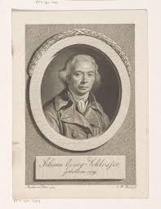
Background: Schlosser
In a footnote, Schlosser criticizes Kant’s philosophy:
“A criticism that denies reason this [intuitive knowledge] would not purify it, but would emasculate it…It would be at risk of soon degenerating into a mere pattern-factory…In the next generation thinking would introduce the old scholastic peripateticism…Since prejudice and superstition have been stripped of their taming power, the most irregular libertinism would follow, until thinking and acting are lost in barbarism…The kind of morality this system has retained from the shipwreck of reason has become so subtle that it will hardly be able to withstand the struggle with vice.” (Schlosser 1795, pp. 182-183)

Slide 4
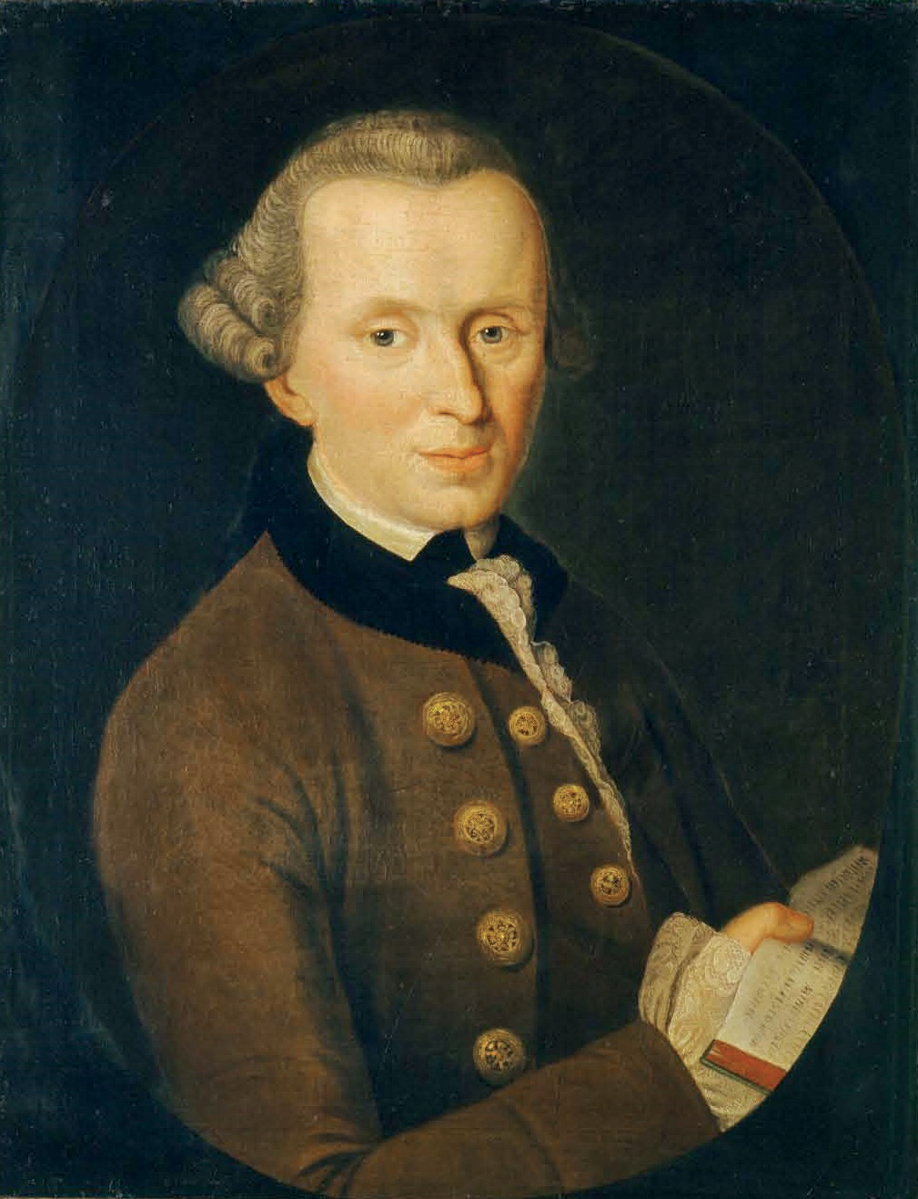
Background: Kant
Kant responds in a pamphlet sarcastically entitled “On a Recently Prominent Superior Tone in Philosophy”.
Kant saw Schlosser representing a “new superior tone” of Platonic mysticism which tended to locate reality beyond the world of sense (i.e. Plato’s ideas in the World of Forms vs. Kant’s ideas as products of reason)
Kant sarcastically refers to Plato as “the father of all enthusiasm”, and Neo-Platonists like Schlosser as “Men of might” and “Men of genius” who are able to “accomplish by a single piercing glance within them everything that industry can ever hope to achieve, and a good deal more besides.” (“On a Recently Prominent Tone, 8:390)
He also refers to them as “naïve enthusiasts” who have access to being itself through intuition (Schwarmerai), which he contrasts against philosophers who labor for knowledge through reason and public discourse.

Slide 5
Background: Kant
Kant then writes a cryptic passage concerning some “test”:
“The summons of the latest German wisdom, to philosophize through feeling (and not, like that of a few years ago, to employ philosophy to put the moral feeling into force and motion), is ultimately exposed to a test at which it is necessarily bound to fail.”
What is this test? What is it for philosophizing to be bound to fail? Why necessary?
I offer two interpretations of this test which attempt to answer these questions:
A semantic interpretation based on Wittgenstein’s Private Language Argument;
An epistemological interpretation based on an internalist view of justification

Slide 6
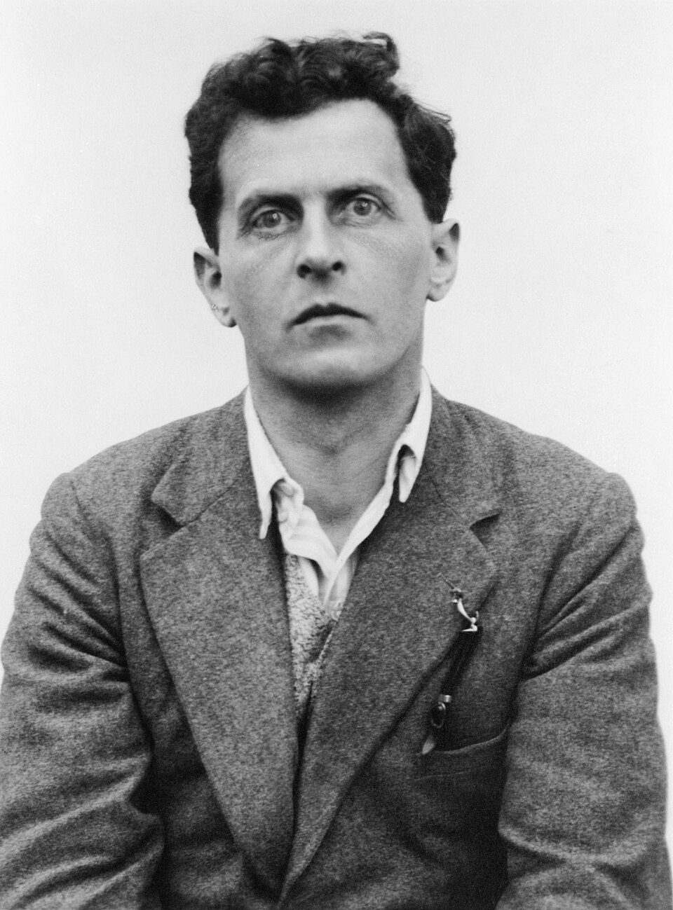
1. The Semantic Interpretation
A private language for Wittgenstein is a language that consists of sensation terms which refer to “immediate private sensations that only its speaker can know.”
Imagine A experiences a certain sensation, ostensively designates it as “S”, and records all subsequent recurrences in a diary, comparing each apparent recurrence S_{x} with the original designated S.
Wittgenstein argues that keeping an accurate record is impossible.
Memory Skepticism: It is difficult to remember what S feels like or to compare its qualitative character to every subsequent S_{x}.
Meaning Skepticism: It is impossible to validate the correct use of “S” by appealing to the same private source whose correctness is being questioned.
That is, someone invokes the authority of her memory as the objective arbiter of the meaning of “S” when it is the credibility of her memory at issue.
E.g. Imagine the absurdity of trying to remember a train schedule by trying to remember the look of the page on which it is found.
E.g. Imagine asking students to check their own quizzes based on what they feel is right.

Slide 7
1. The Semantic Interpretation
How does this apply to Kant’s test?
If some divinely-inspired feeling analogous to “S” leads to true knowledge (e.g. That F-ness is X), nobody else would know what exactly she means, just as nobody would understand an utterance “I felt S” unless there were some public correlate.
E.g. We understand that someone is feeling the effects of hypertension (dizziness) by taking their blood pressure.
Kant’s point here is plausibly that even if “philosophizing through feeling” led to knowledge, there is no way through which one can ever understand what that means.
It is not just that Neo-Platonists are elitist snobs who are unwilling to share knowledge due to their being above question, but that they could not share it even if they wanted to.
Kant calls this the “death of philosophy”, which is inherently discursive.

Slide 8

2. The Epistemological Interpretation
Epistemology is concerned with justification: some account or explanation that gives good reasons to believe that p.
Externalists claim that someone is justified in believing that p based on factors outside of her control, provided they are reliable.
E.g. Someone is justified in believing that it will rain today if a very lucky coin with 100% predictive accuracy says so.
Internalists claim that someone is justified in believing that p iff she can discern and articulate her reasons for belief, and if she has reflective access to her own conscious states.
Pritchard’s example:
Chicken-sexers believe that they subconsciously discriminate between chicks based on their sense of sight or touch.
But research shows, unbeknownst to them, they discriminate based on smell.
For externalists, their chicken-sexing beliefs are justified, but not for internalists.

Slide 9
2. The Epistemological Interpretation
Similarly, for internalists, even if Neo-Platonists’ flashes of intuition lead to true beliefs, it is impossible for them to know where they came from, and thus it would not be justified to place real trust in them.
This would be akin to saying that it is justified to believe it will rain today because a very lucky coin landed tails.
The problem is worse for Neo-Platonists because statements about the super-sensible are impossible to verify.
Therefore, the they are necessarily bound to fail a test because:
They cannot produce adequate reasons for belief;
As philosophers, they are not responsibly acting in accordance with the appropriate epistemic norms.

Slide 10
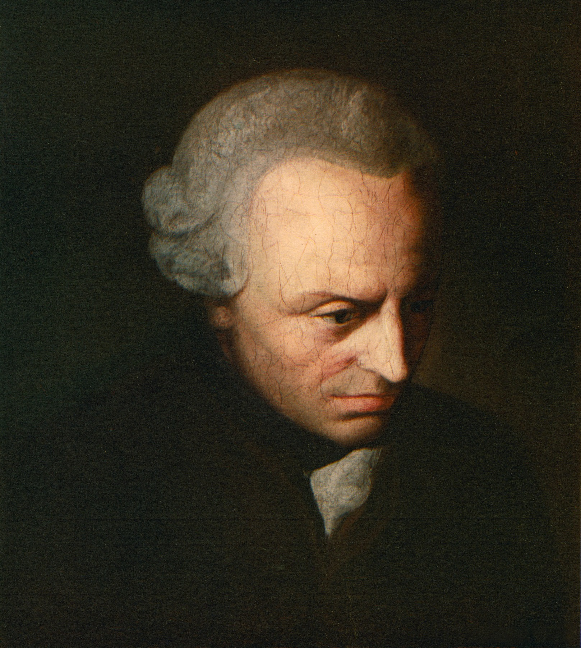
Kant’s View of Reason
Kant associates philosophical reasoning with strenuous “labor” (435) because it involves breaking down concepts and putting them back together through a kind of “craftsmanship”.
The craftsmanship includes concepts found “in the objects themselves” as opposed to some transcendent Platonic reality.
These concepts are “speak clearly to everyone and is capable of being scientifically known”, unlike Platonic intuitions that avoid scrutiny and rational inquiry.
Reason must “brood” over itself and its pure concepts without resort to experience (Prolegomena 1977, 64).
This entails a rigorous examination of the nature, scope, and limits of reason.

Slide 11
Application 1: Ethical Intuitionism
Ethical intuitionists claim that basic moral propositions are “self-evident” and that moral properties are non-natural properties (i.e. not known through sense experience).
Ross (1930): A self-evident proposition is “evident without any need of proof”
Shafer-Landau (2005, 247): “It seems to me self-evident that, other things equal, it is wrong to take pleasure in another’s pain, to taunt and threaten the vulnerable, to prosecute and punish those known to be innocent, and to sell another’s secrets solely for personal gain…One doesn’t need to infer them from one’s other beliefs in order to be justified in thinking them true.”
Audi (2008, 478): A self-evident proposition is true “such that (a) adequately understanding them is sufficient justification for believing them…and (b) believing them on the basis of adequately understanding them entails knowing them.”
If Kant’s argument is true, then moral beliefs attained via intuition are not justified on internalist grounds, nor can we be certain about what our intuitions mean.
That is, someone cannot be justified in claiming that it is wrong to kill just because it self-evidently appears to be true.
Cf. Kant’s system of morality which applies a test of universalizability to determine which maxims are sufficient reasons for action.

Slide 12
Application 2: Blackboxes in AI
Blackboxes are artificial intelligence models that run deep-learning algorithms and are unintelligible to humans.
E.g. Google CEO Sundar Pichai admitted that its AI models performed tasks it was not programmed to do.
Interviewer: “You don’t fully understand how it works, and yet you’ve made it available to society?”
Pichai: “It’s not a big deal, I don’t think we fully understand how the human mind works either.”
There is an ongoing debate about the extent to which we can trust blackbox models, even though they deliver the intended results.
Kant would say it is not justified if we cannot rationally explain our reasons for belief.
Hence there is a growing field called xAI which tries to convert blackboxes into glassboxes.

Slide 13
The Aftermath
Schlosser responded to Kant with a monograph entitled Writing to a Young Man who Wanted to Study Kantian Philosophy.
Schlosser claims to be the sole voice of common sense (but also admits that he had never fully read or understood Kant’s philosophy prior).
Kant replies yet again with his 1796 essay Proclamation of the Immigrant Conclusion of a Treatise of Perpetual Peace in Philosophy, where he wrote:
Henceforth forever wars shall cease
By acting as the sage avers;
And then will all men live in peace
Except for the philosophers.

Slide 14
Semantic and Internalist Justifications of Kant’s Attack on Intuition
Henry Fernando
University of Cambridge
4 October 2025

