Slide 1
The Myth of Rationality
Bob Stone

Slide 2
Views on rationality
Plato: reason gives us all the answers
Kant: only reason can tell us the morally right choice
Plato: only rational people should govern
Kant: reason is in a world beyond the natural world
Russell: “It has been said that man is a rational animal. All my life I have been searching for evidence which could support this”

Slide 3
The plan
1. What we think is rational thinking often is not at all rational
2. When it is, that is not a description of what goes on in the mind, but of the outcome

Slide 4
A must-read book
Daniel Kahneman
Thinking, Fast and Slow
System 1 and System 2

Slide 5
System 1: cognitive biases
Ideas accepted if . . .
Familiar
Presented nicely
Fit what we believe

Slide 6
And we . . .
Jump to conclusions (WYSIATI)
Are influenced by irrelevant ‘nudges’
Can’t handle statistics for toffee

Slide 7
The data
“Linda is 31 years old, single, outspoken, and very bright. She majored in philosophy. As a student, she was deeply concerned with issues of discrimination and social justice, and also participated in antinuclear demonstrations.”

Slide 8
The possibilities
a) Linda is a teacher in elementary school
b) Linda works in a bookstore and takes yoga classes
c) Linda is active in the feminist movement
d) Linda is a psychiatric social worker
e) Linda is a member of the League of Women Voters
f) Linda is a bank teller
g) Linda is an insurance salesperson
h) Linda is a bank teller and is active in the feminist movement

Slide 9
I, ME, MYSELF
Just one of me
The product of all my life to date
The subject of all my thinking and other experiencing

Slide 10
More biases
Inherited beliefs and attitudes
Loyalty to our existing beliefs
Loyalty to the beliefs of our family and culture
Wishful thinking
Laziness
‘Reasoning’ = rationalising

Slide 11
From intuition to reasoning
Kahneman:
System 1 v System 2
Bayne:
Associative v systematic

Slide 12
‘Systematic’ thinking
A huge variety of things are going on in different people’s minds: no single description applies to all ‘reasoners’
What they all have in common is that they come up with the right answer, and can explain it
It’s not the process but the result that counts

Slide 13
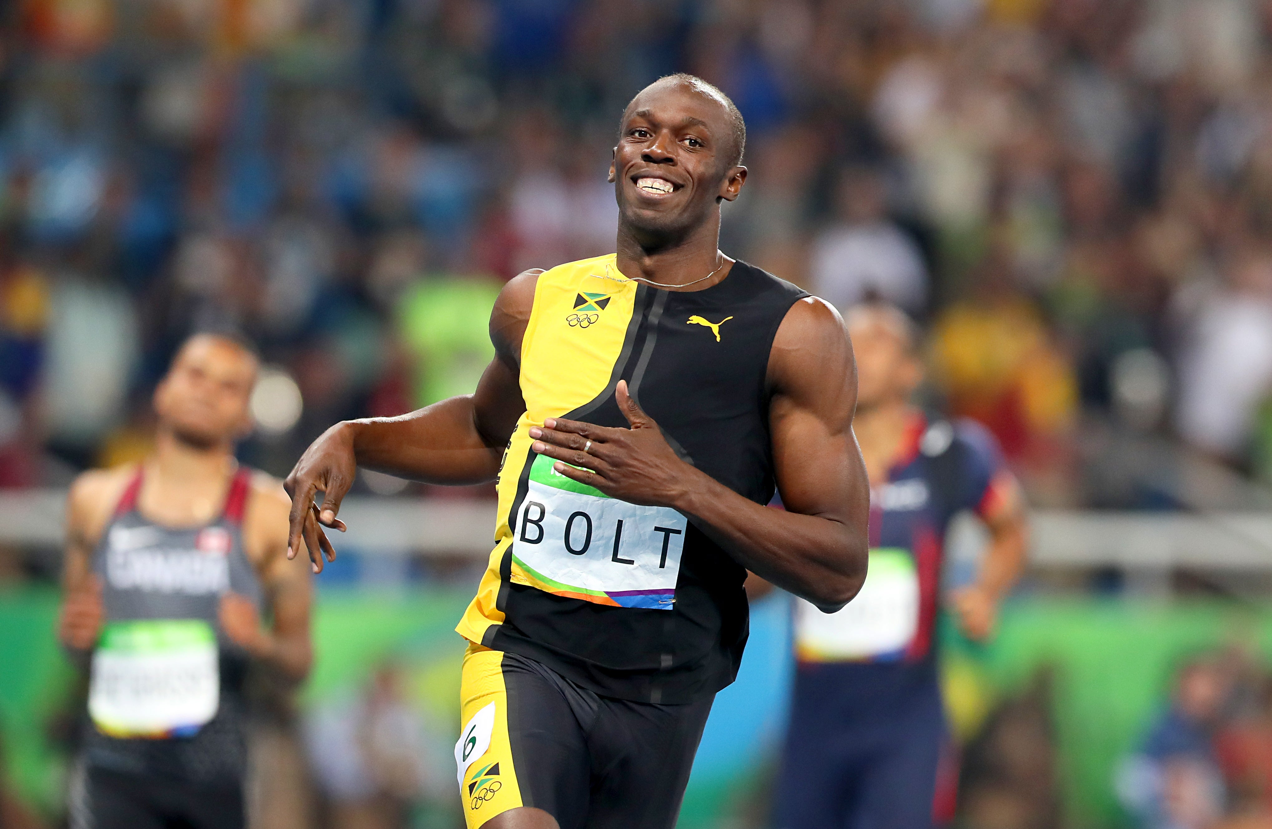

It’s the result that counts . . .

Slide 14
Deductive Problems
7 x 2
7 x 15
The 1-in-a million medical condition: what is the probability of a positive diagnosis being correct if given by a 99% reliable test?

Slide 15
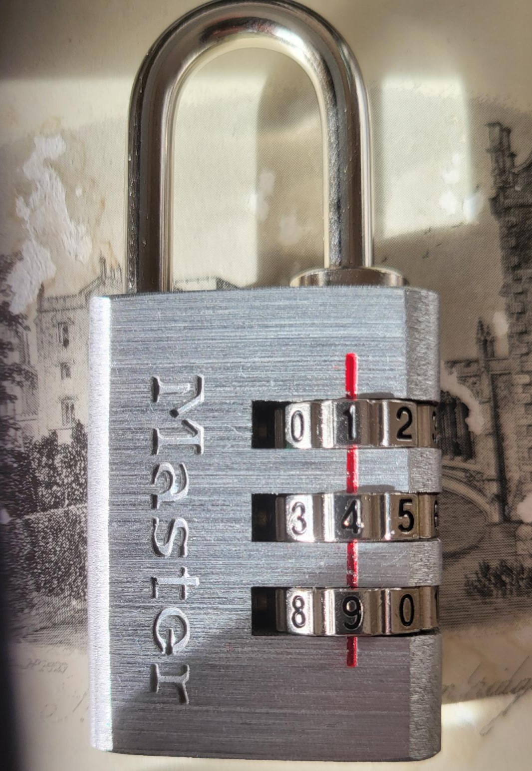
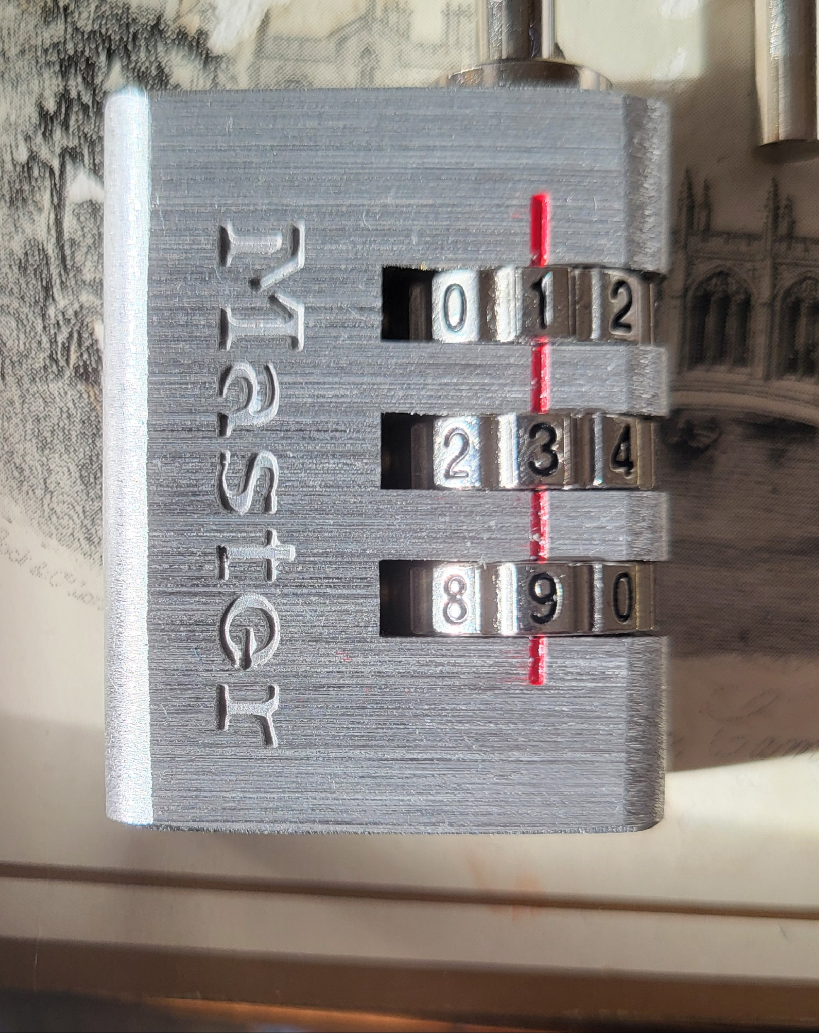
The Case of the Misbehaving Padlock

Slide 16
The process
The method occurred to HIM but not to ME
(he’s perhaps done this before, or he’s just cleverer)
It occurred to him that it would not take long to see if it worked
He followed the method until it worked
Had it not worked, some other method might have occurred to him, or even to me

Slide 17
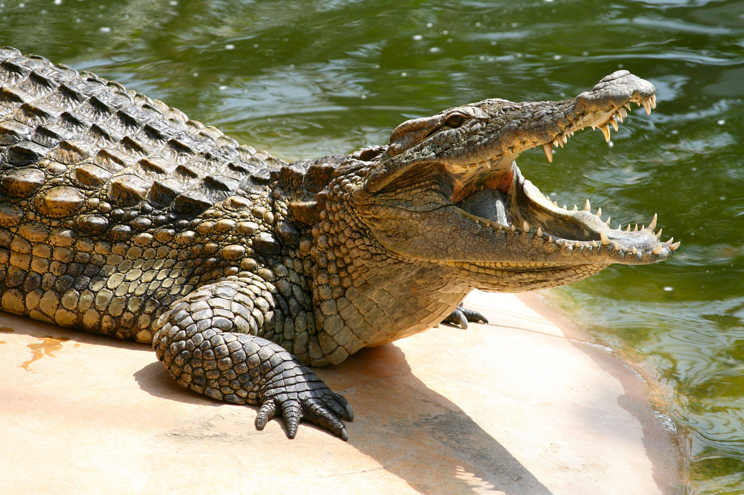
Memories and ideas
You can’t bring one to mind deliberately: it has to be prompted by
either an idea already in the mind
or some stimulus from the environment
You can’t avoid a memory/idea that is triggered

Slide 18



Intelligent thinking can be done unconsciously
walking
talking
driving

Slide 19
Summary
1. System 1 thinking is prone to hundreds of cognitive biases
2. System 2 thinking (‘rational’, ‘systematic’) consists of
Anything at all! including maybe . . .
    Automatic responses to stimuli
    Methods of working out that we’ve learnt, if we remember them and they occur to us
It’s rational IF AND ONLY IF it produces a rational result

