Slide 1
Disintegration of Reason

Slide 2
Perspectives
Nomenclature
2. Instrumental reason
3. Psychology and scientific study
4. Postmodernism and irrationality

Slide 3
Nomenclature
‘Reason’ as term for specific grounds for belief and action.
Still used also in the general sense, but ‘rationality’ more usual
Rationality also psychological term for use of reason in thought and action, both for individual persons and groups.
New pattern of usage roughly dates from late 19th century.

Slide 4
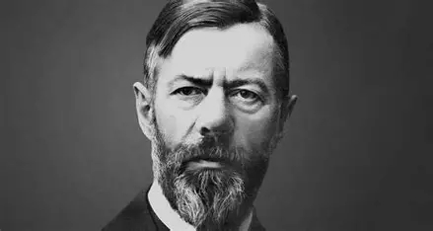
Instrumental Reason
No limits on aims or values
Calculate cheapest or most efficient method
Optimal outcome

Slide 5
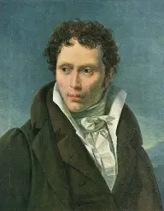
Irrationality and Science
Rational thinking about unconscious processes
Experimental psychology
Not necessarily irrational but unconscious
Politics, including national and other groups
Emotions and evolution

Slide 6
Challenges to reason
Link to ‘instrumental’ reason
Criticism of reason in modern philosophy: historical – Foucault on reason defined against madness; Deleuze against Kant.
Experimental psychology finding poor reasoning capacity

Slide 7
Reason and evolution
Mercier and Sperber introduce evolution by saying reason developed in context of communication and cooperation (socially):
Justification of oneself
Evaluate justifications of others
Argumentation – try to convince/evaluate arguments of others
Interactive setting

Slide 8
Implications for philosophy 1
Evidence that much ordinary reasoning NOT governed by rules of classical logic
Not ‘monotonic’
Oaksford and Chater suggest probabilistic (Bayesian) form for ordinary reasoning
Mercier and Sperber prefer modularist view of inference (reason module more specific than knowledge and decision making).

Slide 9
Implications for philosophy 2
If Mercier and Sperber successful less separation between rationality as study (eg., psychology) and popular thinking or feeling than post-Schopenhauer.
But probably no difference to problem of instrumental reason

