Slide 1
Liberalism is the true path of humanity
OUDCE Philosophical Society – Members’ Weekend
David Burridge - 17 September 2022

Slide 2
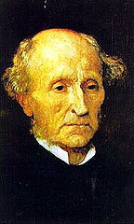
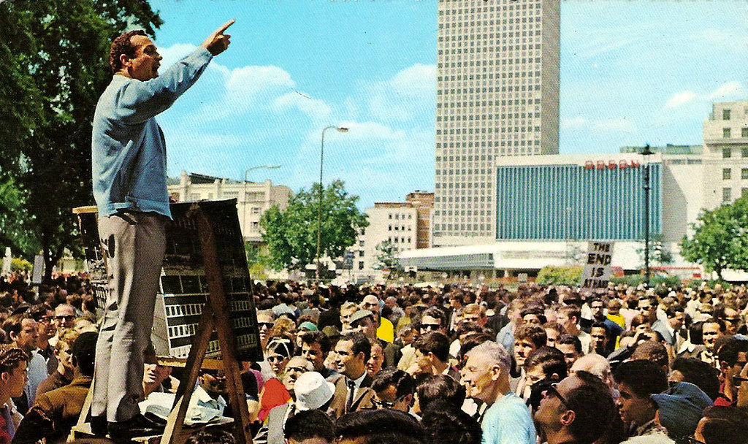
Liberty is a vital principle and the individual must not be deprived of it unless they are doing harm to others.
    John Stuart Mill
Freedom of Expression
This Photo by Unknown Author is licensed under CC BY-SA

Slide 3
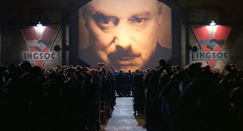
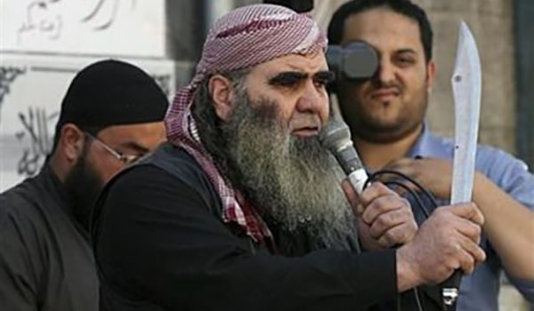
Illiberalism can be exerted by
    Government
Domineering social groups

Slide 4
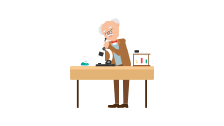

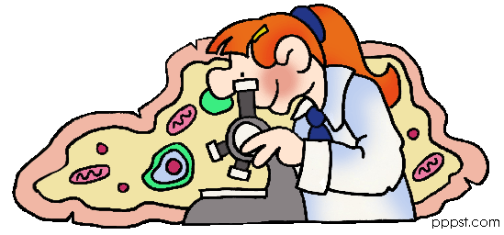



“Wrong opinions and practices gradually yield to fact and argument […]”
If questioned or examined from every angle

Slide 5
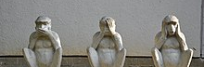
Intellectual pacification
People who have the capability to question keep quiet

Slide 6
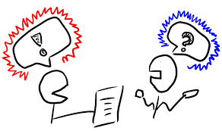
“He who knows only his own side of the case knows little of that” [the truth]

Slide 7


The changing attitudes of creeds
When fighting for
When established in
Recognition
Power
This Photo by Unknown Author is licensed under CC BY
This Photo by Unknown Author is licensed under CC BY-SA

Slide 8
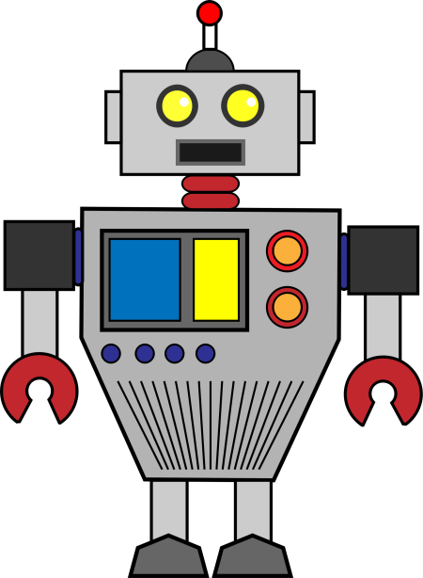

Individuality - Human Nature
Is NOT
It is
This Photo by Unknown Author is licensed under CC BY-SA-NC
This Photo by Unknown Author is licensed under CC BY

Slide 9
“The general tendency of things throughout the world is to render mediocrity the ascendant power among mankind.”

Slide 10

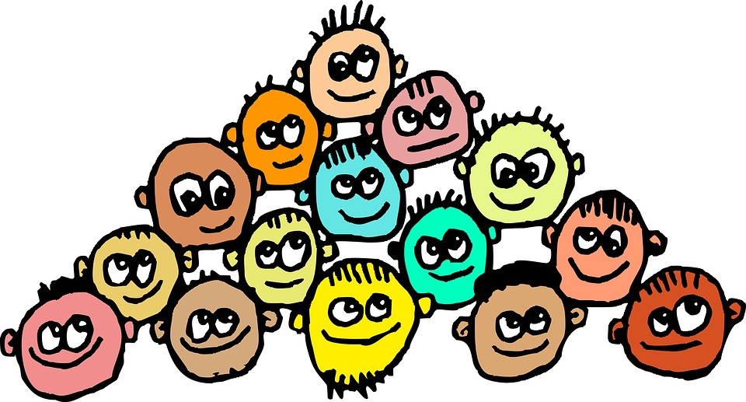
Contrast with Rousseau’s Social Contract
Individual
has priority
over society

Slide 11
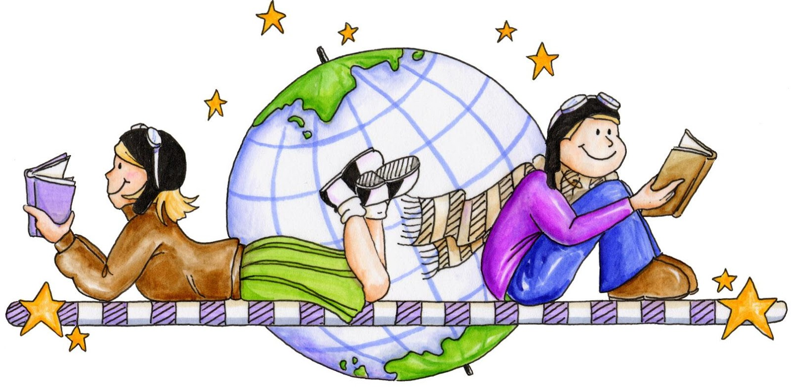
Accountability…
“[..] the individual is not accountable to society for his actions in so far as these concern the interests of no other person but himself.”

Slide 12
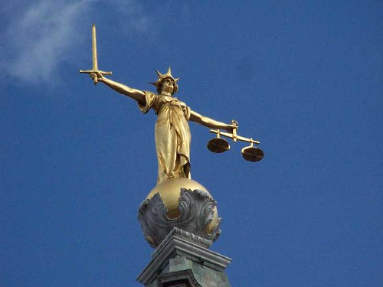
…and Justice
“[…] for such actions as are prejudicial to the interests of others, the individual is accountable and may be subjected either to social or to legal punishment […]”

Slide 13
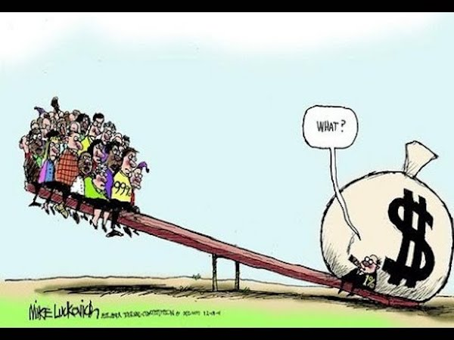
Economic inequality = major threat to liberalism

