Slide 1
Liberalism To Die For
Barbara Wainwright
Oxford September 17th 2022

Slide 2
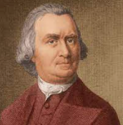
Samuel Adams
Speech to Second Continental Congress
August 1st 1776
“ If ye love wealth greater than liberty, the tranquility of servitude greater than the animating contest for freedom, go home from us in peace. We seek not your counsel nor your arms.
Crouch down and lick the hand that feeds you; may your chains sit lightly on you. And may posterity forget that you were our countrymen.”

Slide 3
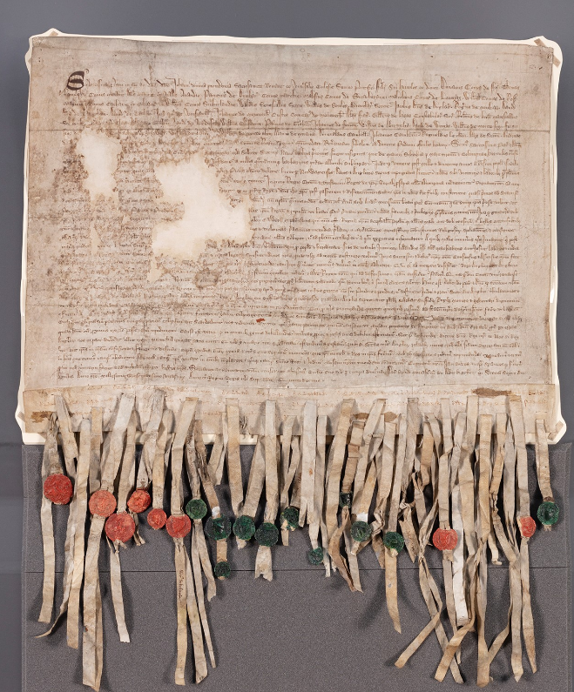
Declaration of Arbroath
6th April 1320
As long as but a hundred of us remain alive, never will we – on any conditions - be brought under English rule.
It is in truth not for glory, nor riches nor honours that we are fighting, but for freedom – for that alone, which no honest man gives up, but with life itself.

Slide 4


Immanuel Kant
Enlightenment is man’s emergence from his self-incurred immaturity. Immaturity is the inability to use one’s own understanding without direction from another. This immaturity is self-incurred if its cause is not lack of understanding but lack of resolve and courage to use it without another’s guidance. Sapere aude! Dare to know! That is the motto of the Enlightenment.
Berlinischer Monatsschrift 1784

Slide 5


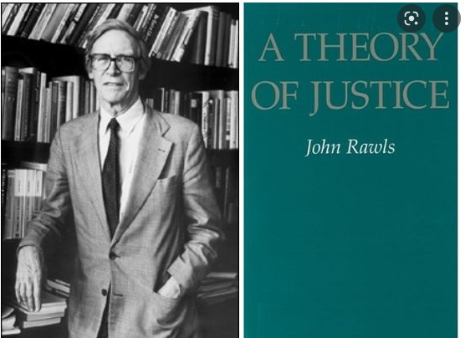

Slide 6
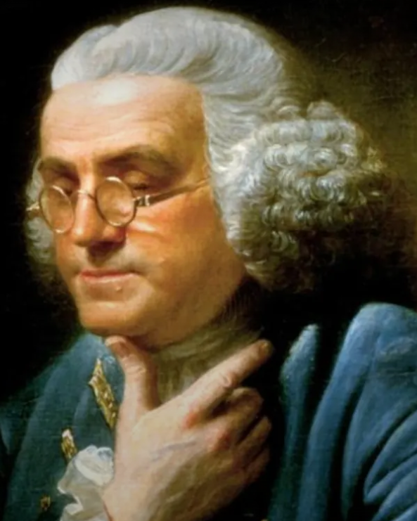
Benjamin Franklin
The rapid progress true science now makes, occasions my regretting sometimes that I was born too soon. It is impossible to imagine the height to which may be carried, in a thousand years, the power of man over matter. We may perhaps learn to deprive large masses of their gravity, and give them absolute levity, for the sake of easy transport. Agriculture may diminish its labor and double its produce; all diseases may by sure means be prevented or cured, not excepting even that of old age, and our lives lengthened at pleasure, even beyond the antediluvian standard.
O that moral science were in as fair a way of improvement, that men would cease to be wolves to one another, and that human beings would at length learn what they improperly call humanity!

Slide 7


Slide 8
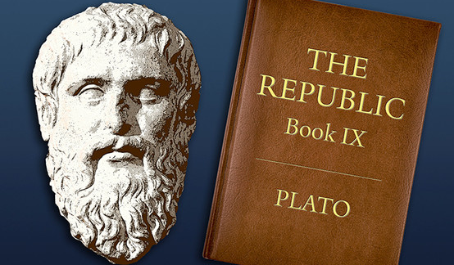

Slide 9
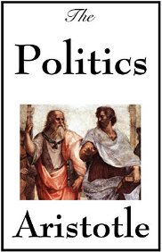
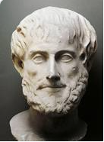
Aristotle
Democracy is not perfect, but is the best system.

Slide 10

“ In England at this day if elections were open to all classes of people, the property of the landed proprietors would be insecure. An agrarian law would soon take place. Landowners ought to have a share in the government ….. They ought to be so constituted as to protect the minority of the opulent against the majority.
Secret Proceedings and Debates of the Convention Assembled at Philadelphia on the year 1787
Speaker James Madison, chief framer of the constitution

Slide 11
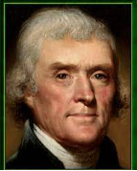
Thomas Jefferson
Men, according to their constitutions, and the circumstances differ honestly in opinion. Some are Whigs, liberals, democrats etc – call them what you will. The others are Tories, serviles, aristocrats etc. The latter fear the people and wish to transfer all power to the upper classes of society. The former consider the people as the safest depository of power in the ultimate. They cherish them therefore and wish to leave in them all the powers to the exercise of which they are competent. This is the division of sentiment now existing in the US.
Letter to William Short 8th January 1825

Slide 12
The Assault on Democracy
Srdja Trifcovic Chronicles July 5th 2016
“The outcome of the United Kingdom’s EU referendum on June 23rd stunned the London based elite class. It laid bare the deep chasm between Britain’s political and media machine and the alienated, angry and disillusioned majority of “left-behind” citizens. Thanks to David Cameron’s miscalculation, the hoi polloi used the opportunity to express their abiding dislike not only of the European Union and all its works, but also of the post-national metropolitan elite class which dominates the political process and media discourse in Britain (as it does in every other major Western country). That class was overwhelmingly pro EU – not least because close to a million of its members have cottages in Languedoc, villas in Umbria etc.
The vote can be seen as a plebiscite on the political system per se”.

Slide 13
The Assault on Democracy
The elite class does not accept defeat, however, because it subscribes to the Bolshevik principle that the march of progressive humanity - of which it is the avant-garde – cannot be stopped by a mere exercise in “democracy”.
Former Prime Minister Tony Blair – a post-human Briton par excellence - thus moans that the 48% who voted to remain feel “disenfranchised”.
He and his ilk across the political spectrum are absolutely livid that yobs, racists and semi-literates from crappy northern towns have dared to defy their wisdom and horrified by the fact (that idiot Cameron!) that the Untermensch scum were given the opportunity in the first place. That mistake must be rectified!
Chronicles
July 5th 2016
Srdja Trifcovic

Slide 14
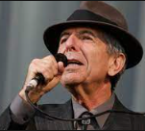
Leonard Cohen
Democracy
From the wars against disorder
From the sirens night and day
From the fires of the homeless
From the ashes of the gay
Democracy is coming to the USA
Sail on, sail on
O mighty Ship of State
To the shores of need
Past the reefs of greed
through the squalls of hate

