Slide 1
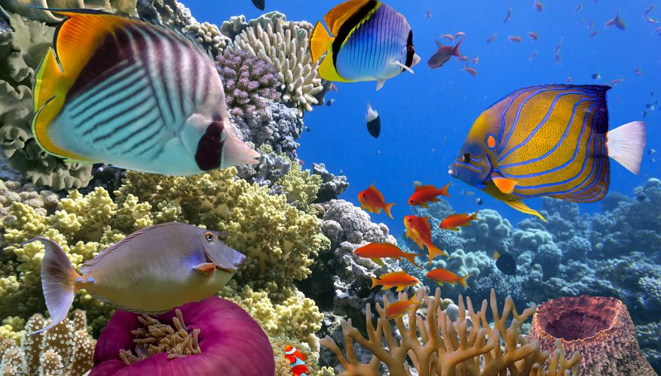
Biogenesis – All Life comes from Life
Tim Bollands
1

Slide 2
Thanks to our all speakers so far !
What is Life?
A family resemblance
LILU - virus, cell, organism, nation
God only knows!
The maintenance of a state
far-from-thermodynamic-equilibrium
An entity which replicates the information
that controls how it does so
Autopoiesis – well, it’s complicated!
Beyond scientific explanation
Is it really not possible to define Life?
Can we exclude machines?
Why only 4 levels? Is there a limit (up & down)?
If not from God, then how did Life begin?
How do they do this?
Does “emergence” count as an explanation?
Circular definition? Is that allowed?
Life is complex, for sure.
But, can’t the definition be simple?
Is it really beyond science?
Or is our current scientific understanding
of Life missing something?

Slide 3
Does Life really exist?
The inability of scientists to agree on a definition of Life suggests one of the following is true:
There is no such thing as Life, i.e. the distinction is entirely arbitrary – it is whatever we choose it to be. Hence, there is no right answer to the question What is Life?
There is such a thing as Life, i.e. there is a correct answer, which does draw a clear and meaningful distinction, and:
  The difference between a living thing and a non-living thing is due to something supernatural (e.g. God, soul), which cannot be explained scientifically
  The difference between a living thing and a non-living thing is due to something natural – some property or capability which can be explained scientifically
✗
✓
✗
✓

Slide 4
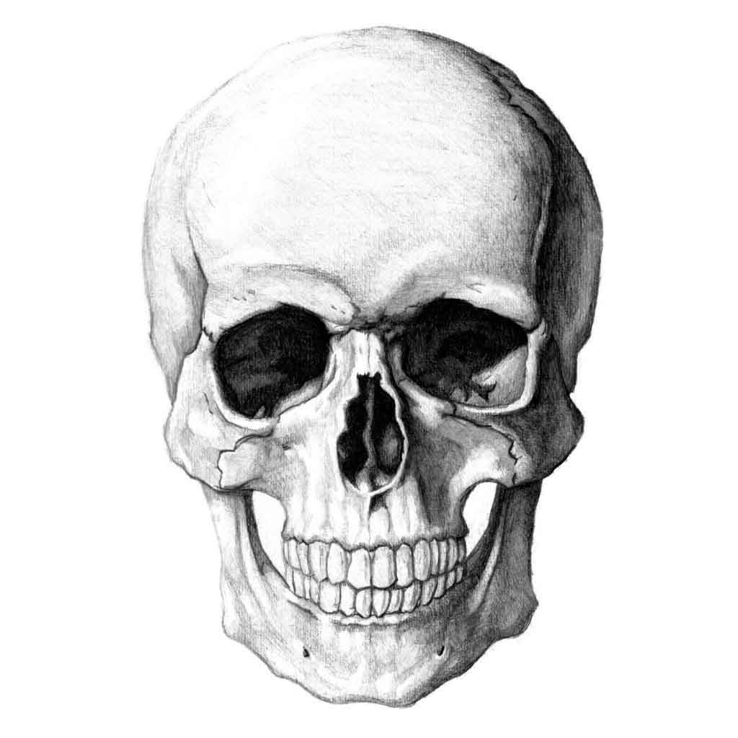
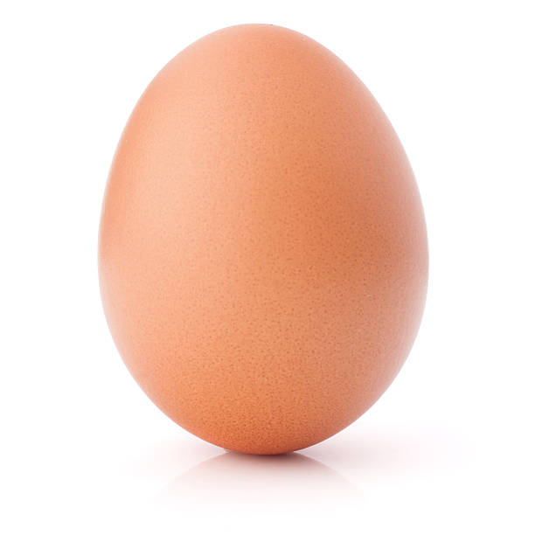
Two natural events unique to living things…
Birth
Death
L I F E

Slide 5
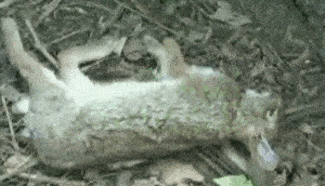
Death
Life is the ability to Die ?

Slide 6
Death
Life is the ability to avoid Death !
Existence
Existence
Living thing
Non-living thing
1
1
0
Time
0
Time

Slide 7
Death
Life is the ability to avoid Death !
Existence
Existence
Living thing
Non-living thing
1
1
Self-maintenance
Maintenance
0
Time
0
Time
Living things maintain themselves !
Non-living things are maintained
by living things (or other natural events)

Slide 8

Self-maintenance
Life is the activity of a living thing to maintain its material existence
despite its hostile environment
But hold on ….

Slide 9
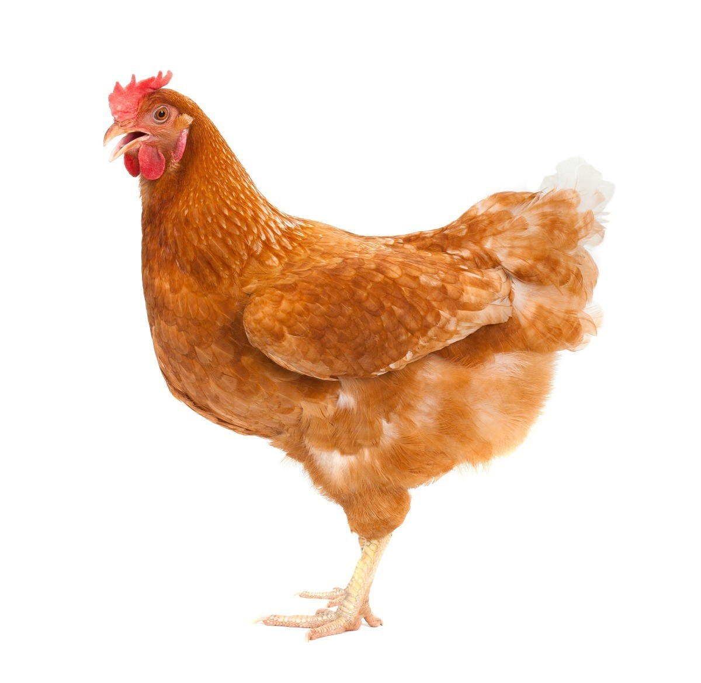
A riddle …
Which came first,
the chicken or the egg?
All Life comes from Life !

Slide 10
Birth
Biogenesis
“Living matter always arises by the agency of pre-existing living matter”
- Thomas Huxley, 1870
99.99999999999999999999999999999999999999999 ….. %
Abiogenesis
The emergence of Life from
non-living matter
1

Slide 11
Birth
Biogenesis
“Living matter always arises by the agency of pre-existing living matter”
- Thomas Huxley, 1870
100%
99.99999999999999999999999999999999999999999 ….. %
Abiogenesis
The emergence of Life from
non-living matter
0
1

Slide 12
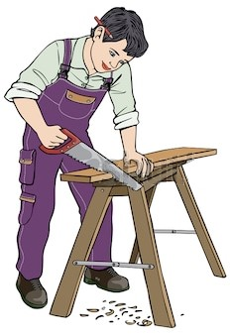


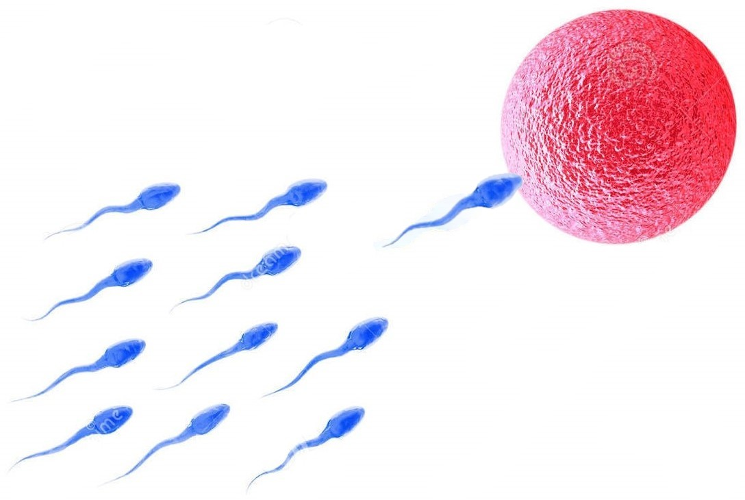
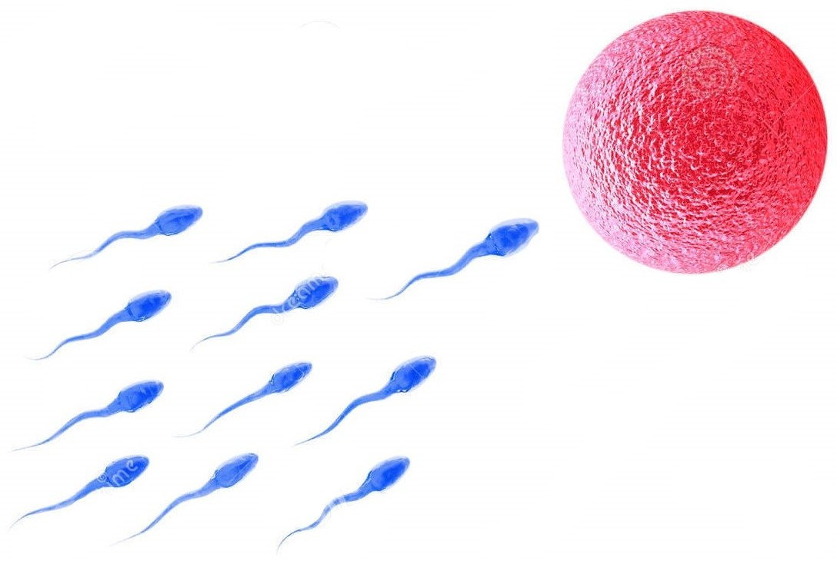
Birth
How are living things created?
Non-living Things
Living Things
Non-living things are created by living things
(or other natural events)
Living things create themselves
from other living things !

Slide 13
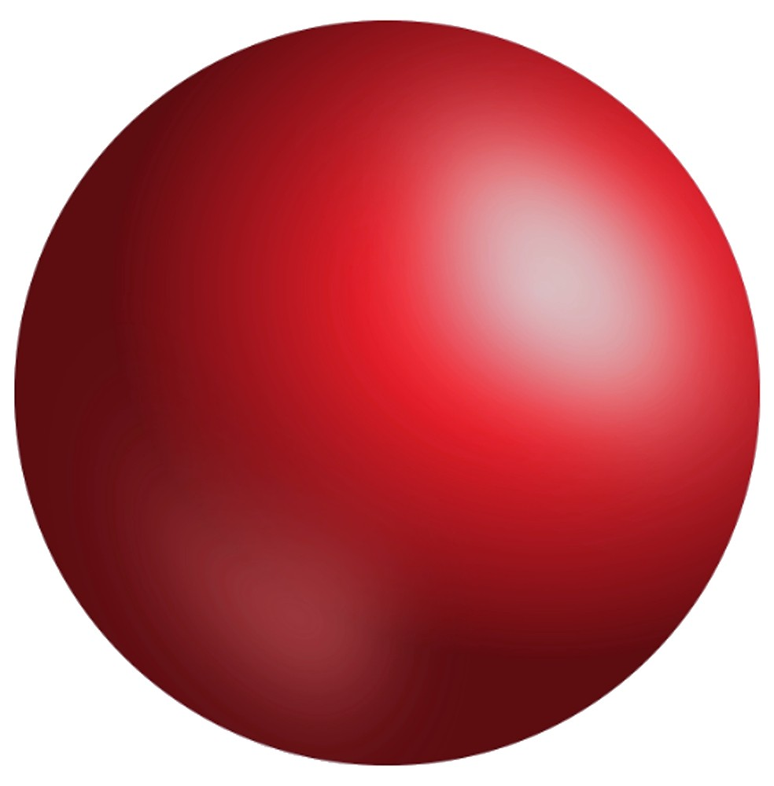
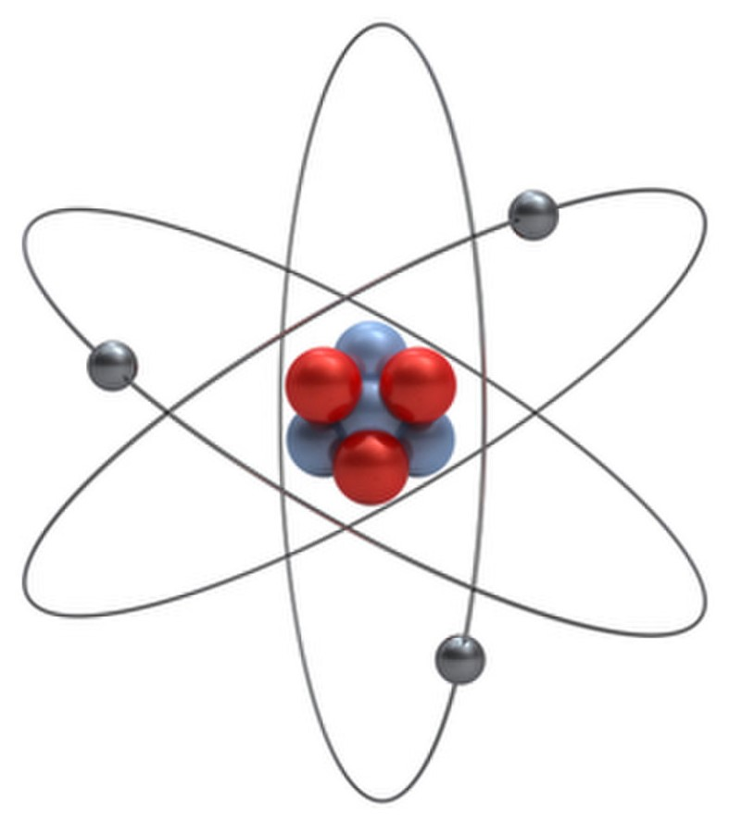
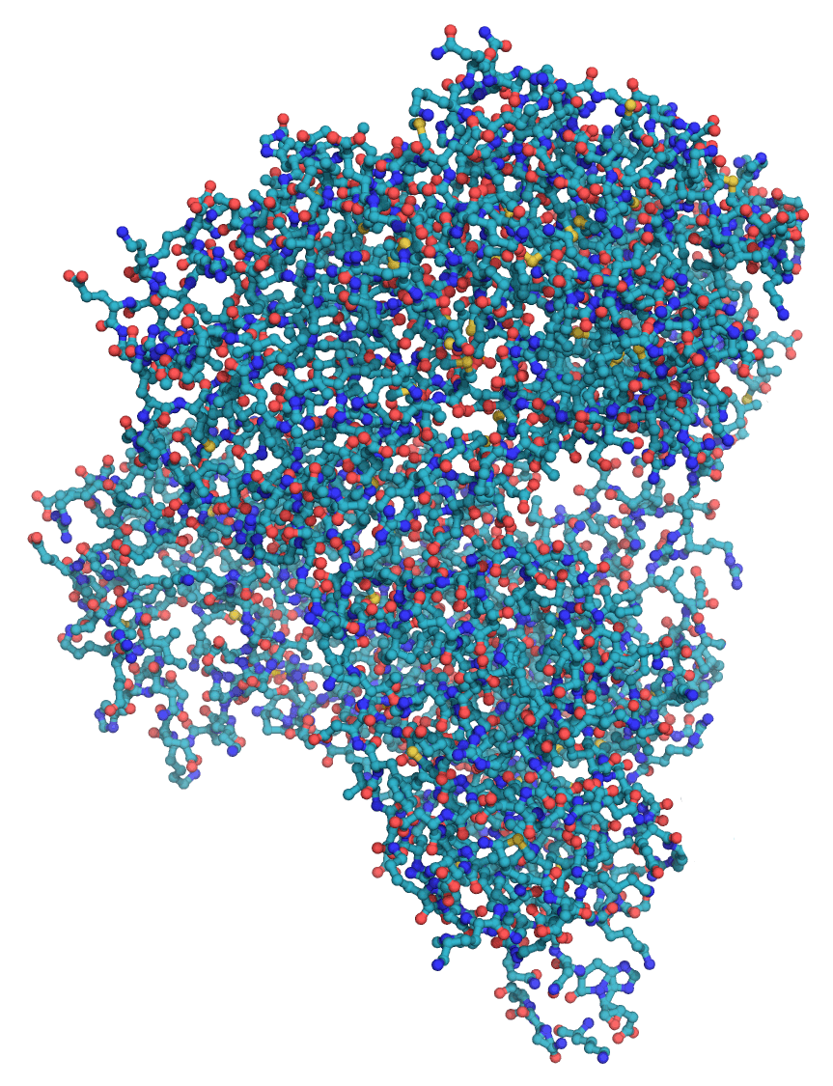
Life = Self-creation & Self-maintenance
Life is the activity of a living thing to create its material existence
from other living things
and maintain that existence despite its hostile environment.
Life is the activity of a living thing to create and maintain its material existence
✓
But if this is correct, then …
Biogenesis is true : All Life comes from Life !
There never was a first ever living thing !
Life has existed for all time …. !

Slide 14
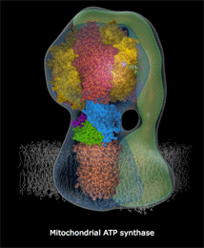
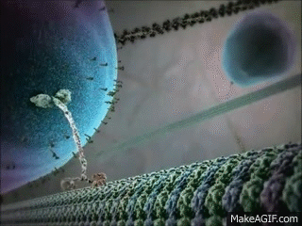
Living molecules
Notes:
…. of the enzyme. Here is an image representing more of what is known about its structure, though colour has been added to identify the parts.
We can say that the enzyme and ADP cooperate to achieve an end. Thus it seems that competition and cooperation are intrinsic properties of atoms and molecules.
When the refining process of selection is added, competition becomes the main driving force of Darwinian evolution. Cooperation is merely a way of gaining a competitive advantage – two entities working together achieve what they cannot when working alone. Three entities can be more efficient than two, and so on, thus complexity increases.
There is a limit to the level of complexity that can be achieved in inorganic chemistry but the variety of compounds that can be formed from chains of carbon atoms joined together is practically limitless. The difficulty is that long carbon chains are fragile and do not survive high temperatures – they can be assembled only under more gentle conditions. Shorter carbon chains are more robust.
Although polymerisation was understood in the first half of the twentieth century, it was thought that organic monomers could only be synthesised by living things. Then, in 1952, ……..

Slide 15

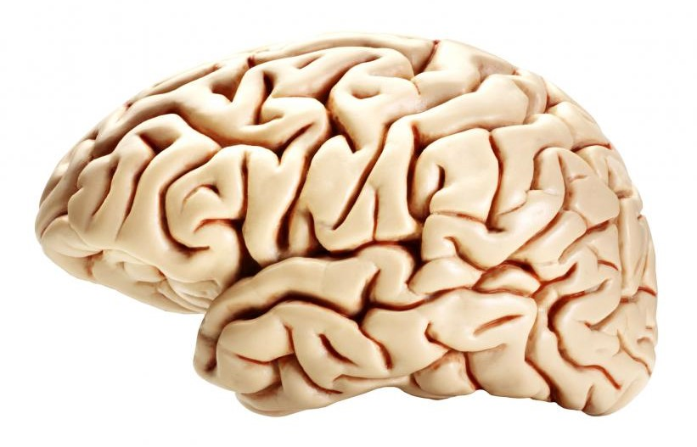
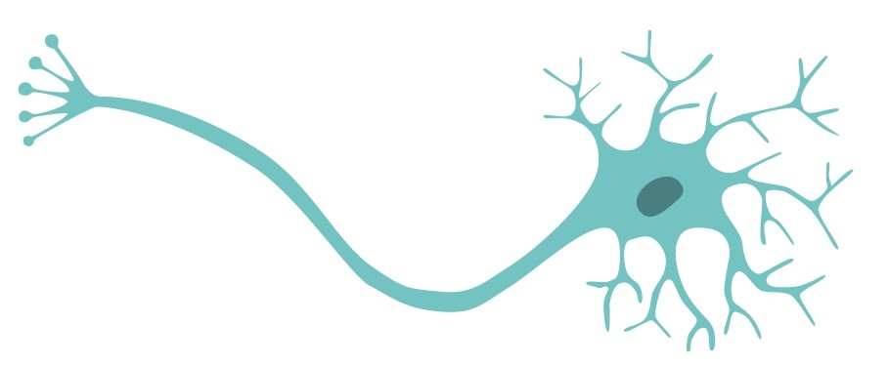
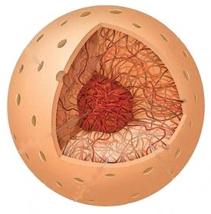
Universal Life
Every living thing is a
community of other living things
(the Universal Life Hypothesis)

Slide 16
Available now on Amazon …
Find me on Twitter @ATBollands

Slide 17
Thanks to our all speakers so far !
What is Life?
Yes, it is !
Yes, we can.
There is no limit
(up or down)
It didn’t !
They are made
from
other living things
Yes, it is.
Yes, it can.
No, it isn’t.
Yes, it is !
A family resemblance
LILU - virus, cell, organism, nation
God only knows!
The maintenance of a state
far-from-thermodynamic-equilibrium
An entity which replicates the information
that controls how it does so
Autopoiesis – well, it’s complicated!
Beyond scientific explanation
Is it really not possible to define Life?
Can we exclude machines?
Why only 4 levels? Is there a limit?
If not from God, then how did Life begin?
How do they do this?
Does “emergence” count as an explanation?
Circular definition? Is that allowed?
Life is complex, for sure.
But, can’t the definition be simple?
Is it really beyond science?
Or is our current scientific understanding
of Life missing something?

Slide 18
What is Life ?
Life is the activity of a living thing to create its material existence
from other living things
and maintain that existence despite its hostile environment.
Living things exist because …
Every living thing is a
community of other living things
(the Universal Life Hypothesis)

Slide 19
THANK YOU
Insert Image

Slide 20
Available now on Amazon …

