Slide 1
Life: Facts, Fictions and Leaps of Imagination.
Presentation for the Philosophical Society Members’ Weekend 2020
By
Fauzia Rahman-Greasley

Slide 2
Thesis
All attempts to answer the metaphysical question “What is Life?” are based on the assumption that Life is explicable, rather than simply saying that Life is a brute fact. By ‘brute fact’ I mean ‘a fact that has no definition or something that cannot be explained’.
Nonetheless the question is philosophically interesting because of what attempts to answer the question show about human agency and imagination.

Slide 3
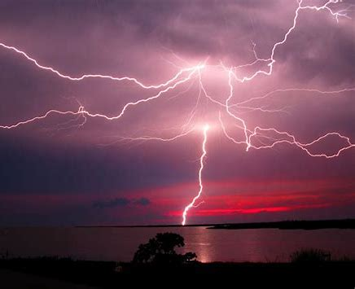

Is there a scientific answer to the question “What is Life”?
Scientists have demonstrated that phenomena previously considered “mysterious” are explicable without needing to talk of God or gods
Thor is angry
A gift from God

Slide 4
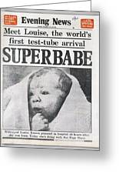
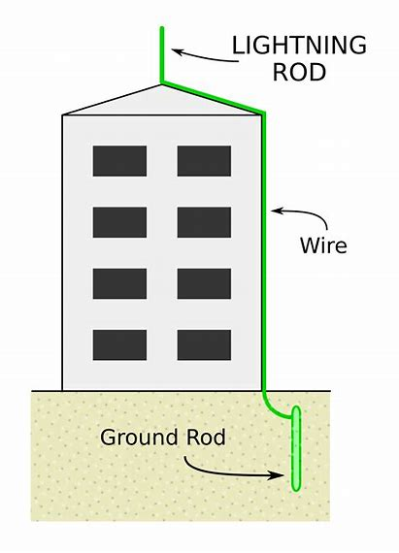
Public demonstration of the practical uses of scientific explanations

Slide 5
It is certainly true that science has provided alternative credible explanations to supernatural ones. However, it does not follow that it is possible for science to provide a complete explanation of Life.
Explaining vs. Explaining away

Slide 6
Etymology of Life
Before we can answer the question “What is Life?” we must answer the question “What does the word ‘life’ mean?”
Body
Replaces one word with another – not very informative!

Slide 7


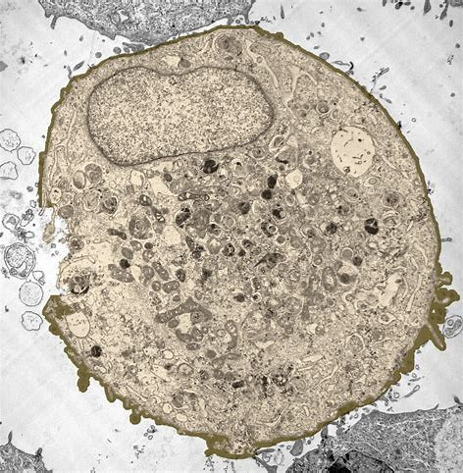
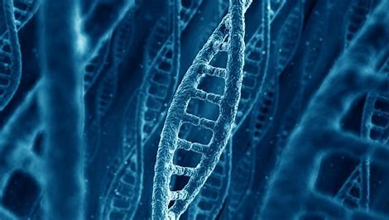
Nomological Fallacy
It is a mistake to believe that the name (Life) provides knowledge about the nature of the phenomenon.
“Life” : (noun) seemingly referring to an object: something we can see.

Slide 8
Life is a sequence of observations (a process)

Slide 9
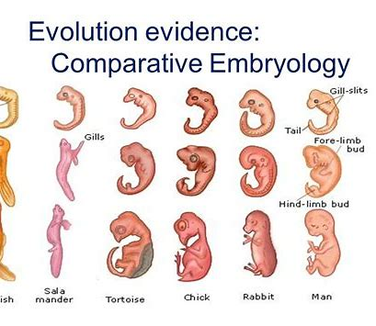

Slide 10
“Life” means “An Explanation of how one observable becomes another”
An explanation is not something we see with our eyes: it is a plausible, coherent, or credible ‘story’ of the connection between two or more observables – something we invent or imagine, rather than something we discover by direct observation.
We do not literally see the connection (Hume).

Slide 11
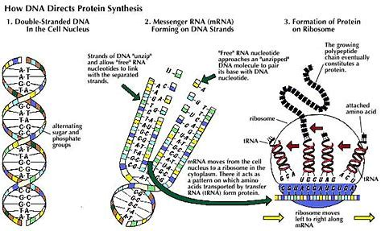

Slide 12
“The faculty of imagination is a blind but indispensable function of the soul without which we should have no knowledge whatsoever, but of which we are scarcely conscious” (Kant, Critique of Pure Reason, B104| A78)

Slide 13
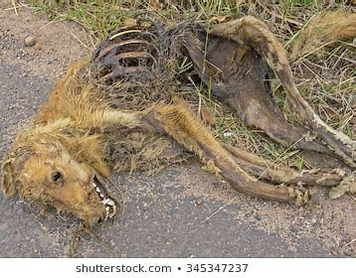
“Life” means “the absence, or opposite, of Death”

Slide 14
“Life” means “a property that some things have and others do not”
What does this have
That this does not

Slide 15
Life: Whatever makes the difference between living and non-living things
What are the criteria for distinguishing between the two groups?
Place objects one accepts as “living” in one group, and those considered as “non-living” in another; then attempt to find some attribute, feature, or property that is common to the former and not the latter.

Slide 16
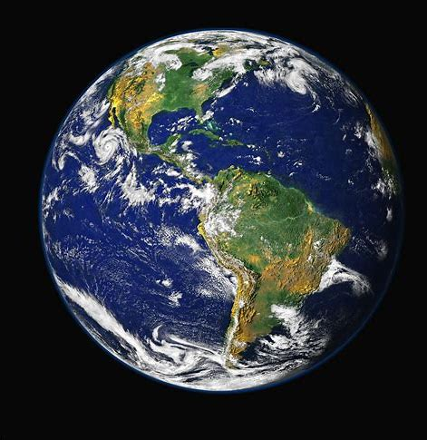
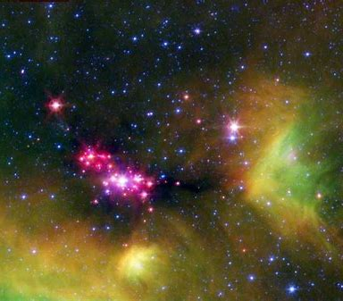
Living or Non-Living?

Slide 17
Reductive Abstractionism
The idea that there is a difference between living and non-living things is an unproved and unprovable assumption.
Life is an abstract idea.

Slide 18
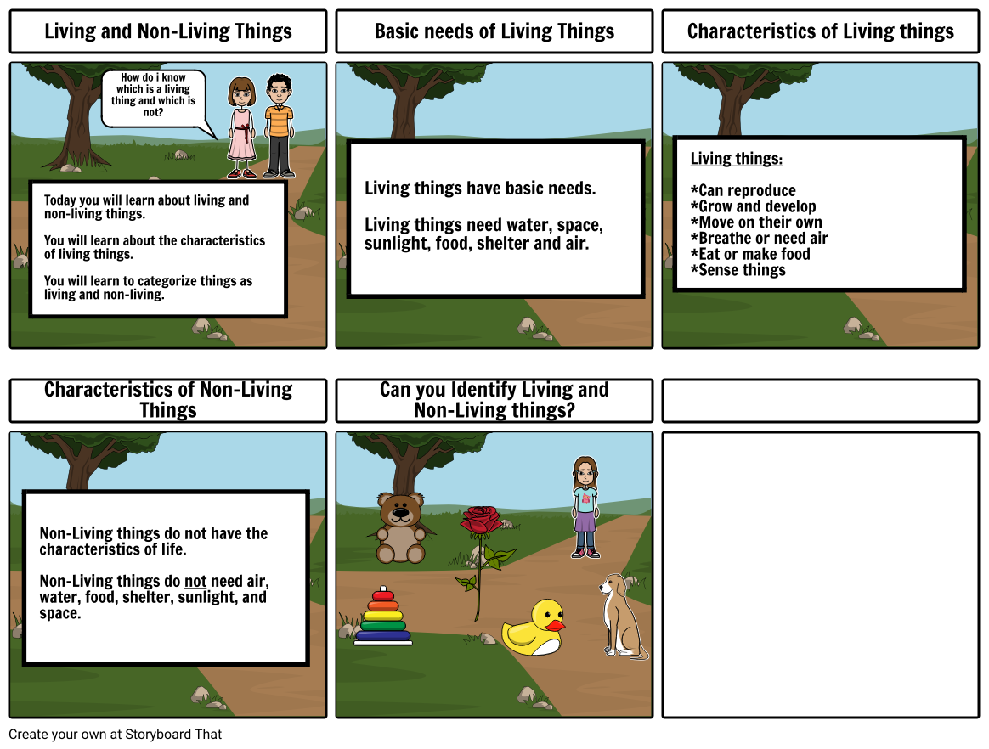

Slide 19
We learn from others to name and categorise: X belongs to the group we call “living things” and not to the group of “non-living things”.
Objects do not give themselves names and Nature does not categorise. Naming is a human activity.
We can divide the objects however we want, or according to whichever theory we want to promote.
Therefore, the identification of a particular entity as belonging to the group of living things, rather than of non-living things, turns out to be purely arbitrary.

Slide 20
“Life” is a word that derives its meaning from its use in social communication: not from nature.

Slide 21
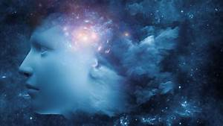
“[T]he familiar, just because it is familiar, is not cognitively understood. The commonest way in which we deceive either ourselves or others about understanding is by assuming something as familiar, and accepting it on that account […]
such knowing never gets anywhere, and it knows not why.”
(Hegel, The Phenomenology of Spirit: 18)

Slide 22
“Philosophy is a battle against the bewitchment of our intelligence by means of language.”
(Wittgenstein, Philosophical Investigations)

Slide 23
“There is a two-way movement in philosophy, a movement towards the building of elaborate theories, and a move back again towards the consideration of simple and obvious facts.” (Iris Murdoch)

Slide 24

The Problem of the Post-Truth Era

Slide 25
Post-Truth is a logical consequent of human activity
“God is dead”

Slide 26
Belief: Subjective / psychological Truth – what an individual or group happens to accept as true. Even if there is widespread consensus that a belief is true, it does not follow that the belief is true or even approximates with truth.
A belief, however strongly held, can be objectively false (although it cannot be subjectively false).
Fact: Objective Truth -- What is true independently of whatever an individual or group happens to believe.

Slide 27


Objectivity vs. Subjectivity

Slide 28
Classical Tripartite Theory of Knowledge (Plato)
I know p if and only if I believe p and have reason to believe p and p is true independently of whatever I happen to believe.
Implies: I accept p independently of whatever others happen to say.
Social Theory of Knowledge (Foucault)
I know p if social forces compel me to accept p
According to this view, objective truth is not a necessary condition for knowledge. The belief of a social group (eg. a scientific community) is sufficient for knowledge.
Normative or orthodox view.
Preference Theory
I accept p if p is preferable to not-p.

Slide 29
“The idea of ‘objective reality’ […] undergoes important modifications when it is to be understood, not in relation to the ‘world described by science’, but in relation to the progressing life of a person.” (Iris Murdoch, The Sovereignty of Good: 25)
We literally see and can point to a human body but a person is more than a body. A person is a body with inner experiences: not a body + inner experiences.

Slide 30
Certainty
I can doubt the existence of my body but not my inner experiences.
I am certain of my inner experiences but not of what others tell me my experiences are (they might be mistaken).
I am certain I experience sequences of observations and feelings that appear ordered in space and time.
Sometimes I speculate (imagine alternative truths) about the nature of my experiences. When I speculate I create additional possible truths.
Therefore (from 4) imagination must be possible. BUT: I do not need argument to prove my experience of imagining alternative truths!
Therefore, (from 3, 4 and 5) I am certain that (a) there are possibilities and (b) more possibilities than I can imagine. (I have an innate concept of more and less).

Slide 31
I am certain that it is possible for me to choose whether to speculate and whether to attempt to actualise a possibility.
I am certain that I can choose to speak or to be silent: it is not necessary for me to put my thoughts into words unless I want you to know my thoughts.
I can know what you mean when you use the word “life” if and only if you tell me: I do not have epistemic access to your thoughts or experiences.
I experience being an entity embedded in a network of language-users with the capacity to choose from a finite but changeable number of possibilities.

Slide 32
Speculation
By “life” I mean “a finite but changeable number of possibilities some of which are possible to actualise”.
Whether that definition rings true for you, and what follows if it is, is for you to decide!

Slide 33
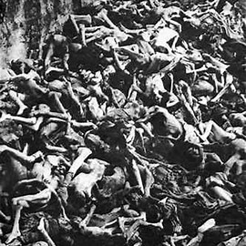
Is Life after Death possible?

Slide 34
Life: Are there any Facts?
A person’s actions either increase or decrease the possibilities available for others.
Each and every one of us is a co-creator, not creator, of possibilities

Slide 35
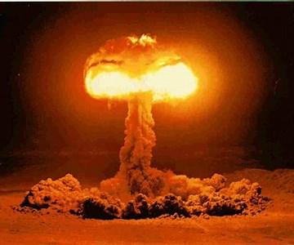

Slide 36
Conclusion
In doing philosophy we must inevitably use words. Yet, words are the source of misunderstanding and confusion.
It is clearly true that we can theorize about Life; but theories are not facts: they are fictions which we might be persuaded to accept as truth.
Given that we experience numerous moral dilemmas, what matters is answering the ethical question “on what grounds ought I to act?”
The question ‘What is Life?’ is not only unanswerable, it is also irrelevant.

Slide 37
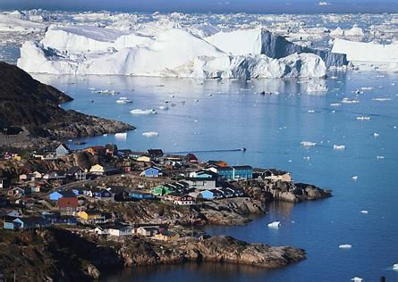
Thank you for listening

Slide 38
Compassion
The Compassionate Mind Foundation (founded by Paul Gilbert) https://www.compassionatemind.co.uk/
The Charter for Compassion (founded by Religious Historian, Karen Armstrong)
https://charterforcompassion.org/

