Slide 1
What is life?
God only knows
Oxford Philosophical Society Member’s Weekend
Presenter: Jeff Morris

Slide 2

Is life a property?
Images by Carla Veldman

Slide 3

Is life an emergent property?
Images by Carla Veldman

Slide 4
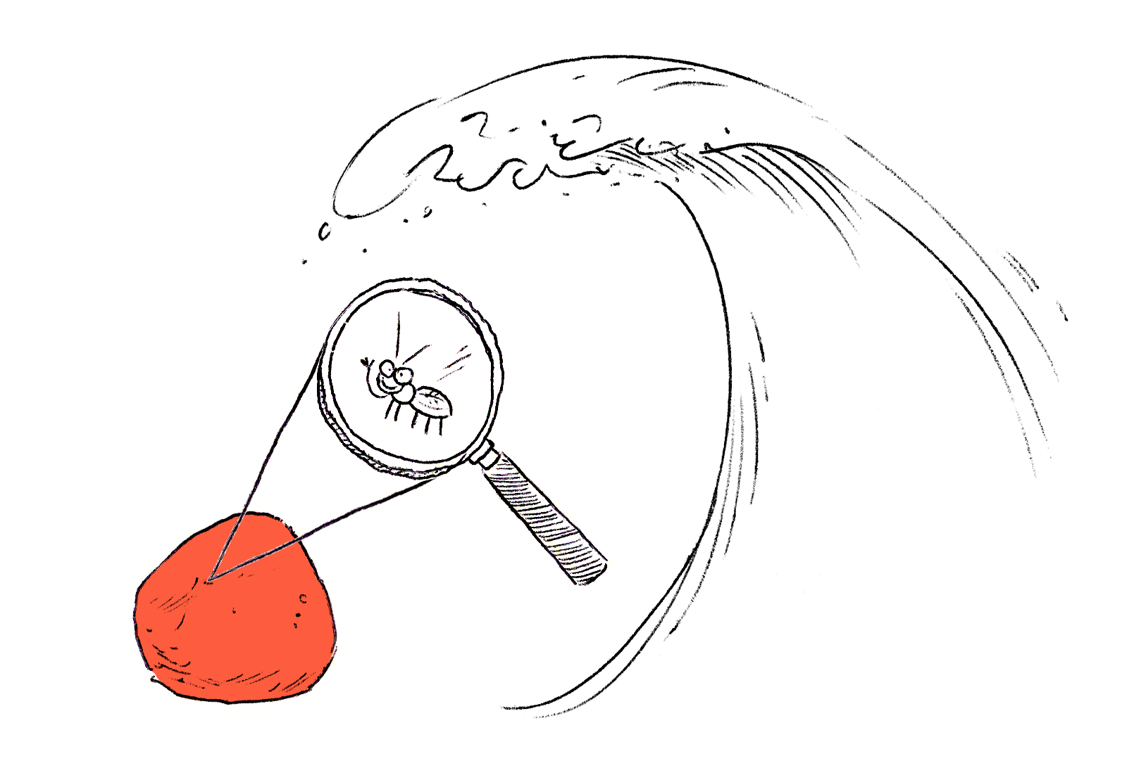
Is life an emergent property?
Images by Carla Veldman

Slide 5
God does not exist
Who created God?
Problem of Evil

Slide 6
God does exist
Ontological
Cosmological & teleological

Slide 7
Attributes of God
Greatest conceivable being
Exists necessarily
Aseity
Immutable
Immaterial
Causally powerful

Slide 8
What is life?
Necessary
We instantiate it
God only knows the details

