Slide 1
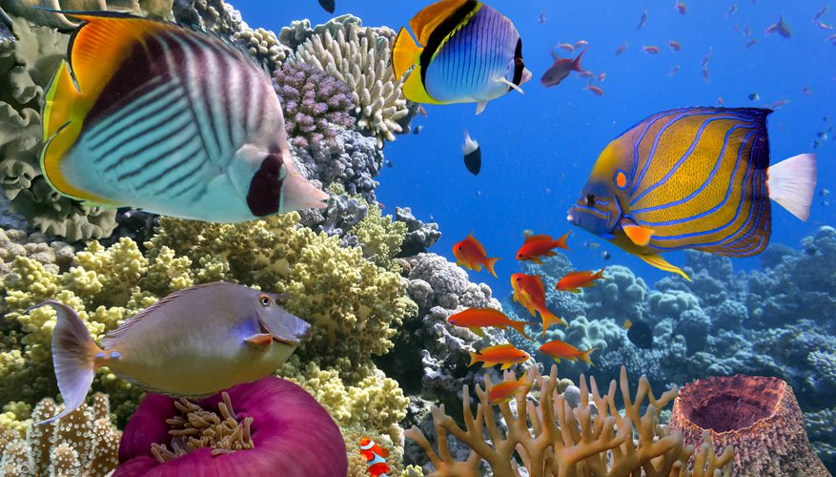
What is Life?
The Philosophical Society - Members’ Weekend, 2020

Slide 2
Introduction to “What is Life?”
Tim Bollands
2

Slide 3
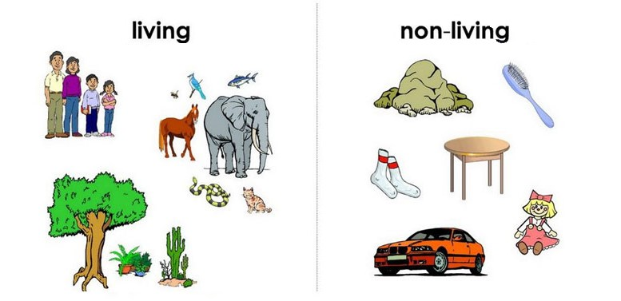
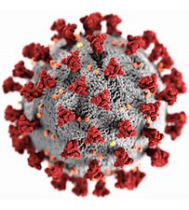

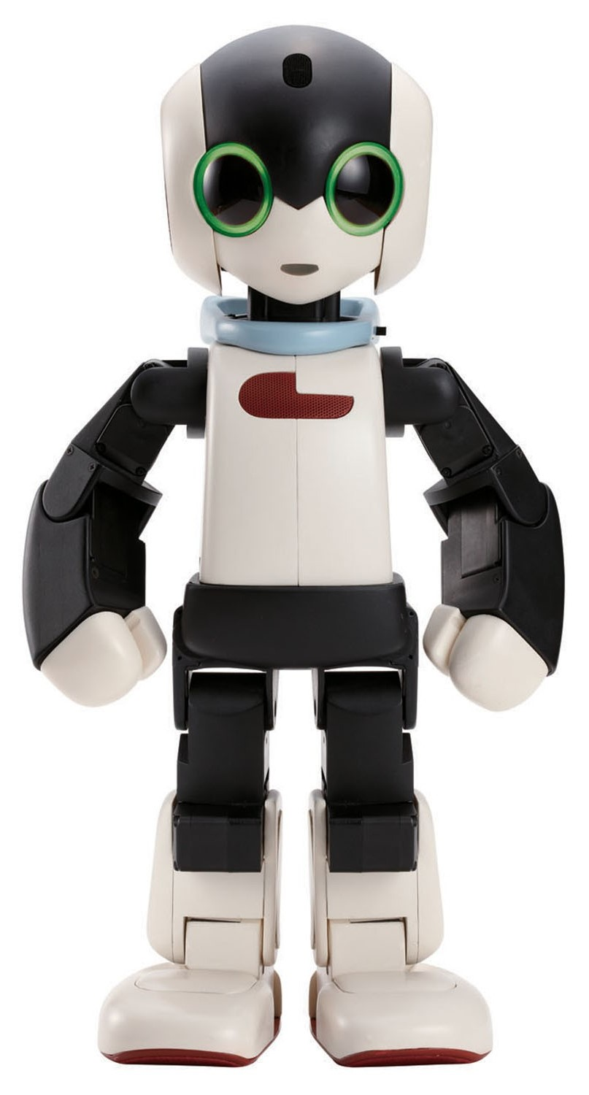
What is Life?
What is the correct definition of ‘Life’? “Life is …..”
What is the distinction between living things and non-living things?
What do we mean by the word “Life”?
What makes a living thing ‘alive’?
?
?
?

Slide 4
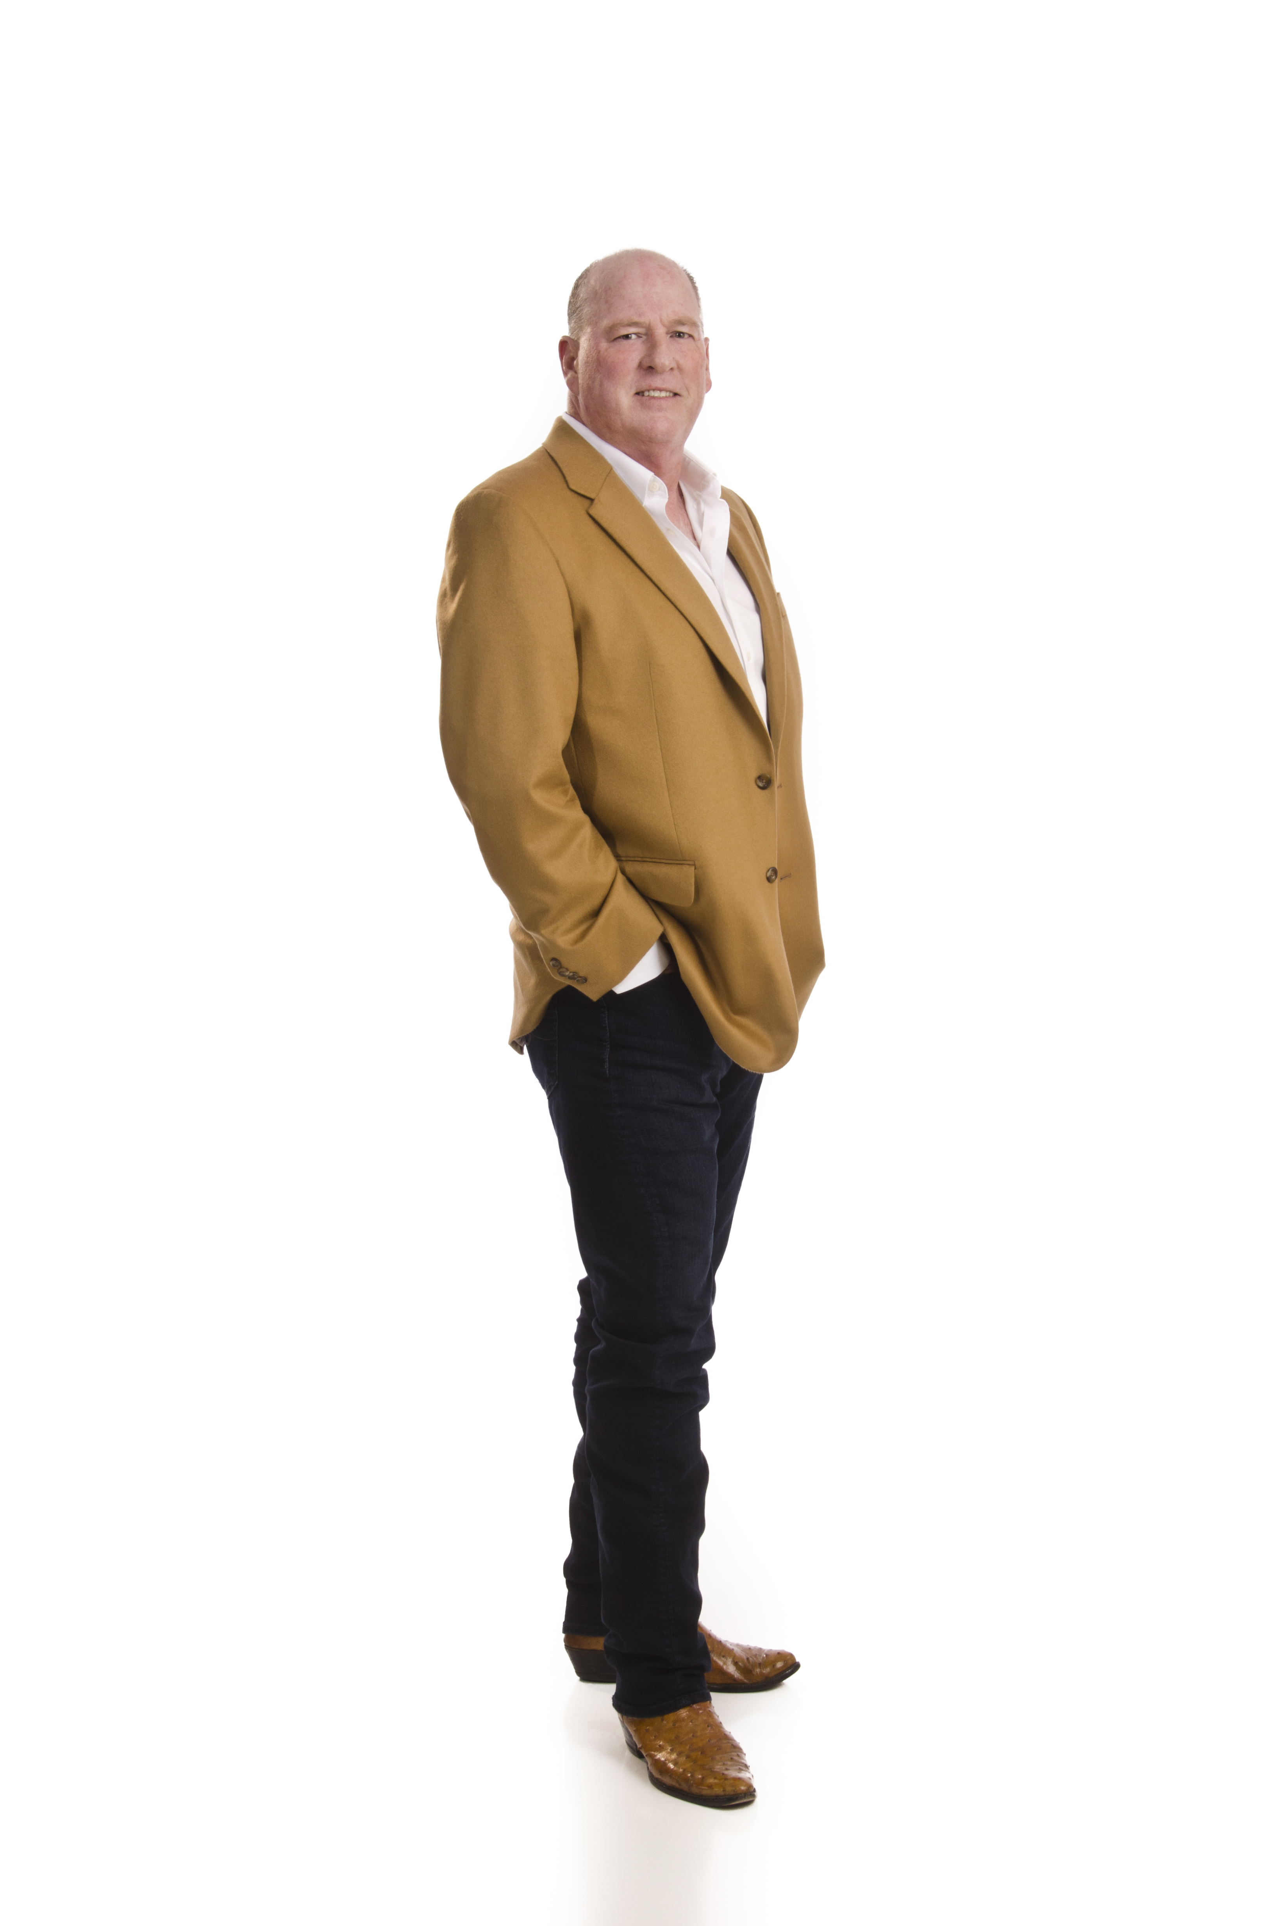
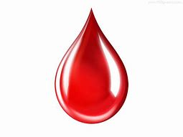


Dualism, Spiritualism & Vitalism
Life-force

Slide 5
Physiology & Biology
A physical machine which…
Grows
Eats
Moves
Responds
Excretes
Reproduces
…

Slide 6
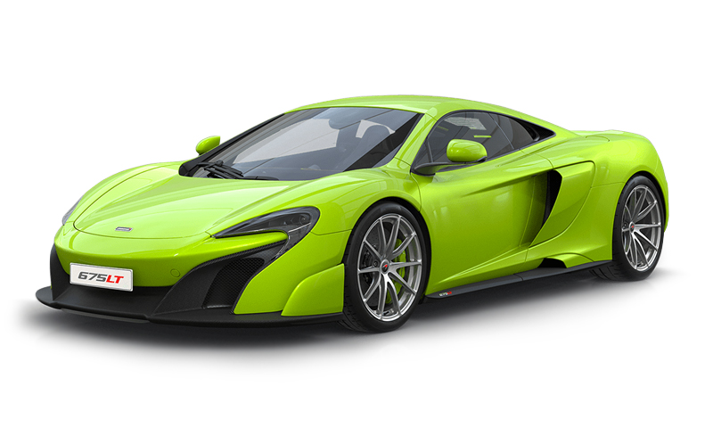
Physiology & Biology
A chemical system involving :
Nutrition
Respiration
Homeostasis
Metabolism
Excretion
Reproduction
…

Slide 7
Physiology & Biology
A biochemical machine which …
is Carbon-based
has Cells
uses water
has DNA
has ribosomes
…

Slide 8


Life on other planets ?
chemical
“A self-sustaining system capable of Darwinian evolution”
v

Slide 9
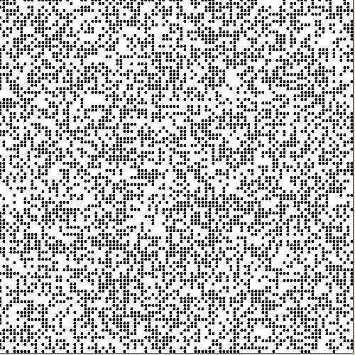

Self-sustaining Patterns ?
John Conway’s ‘Game of Life’

Slide 10
PhilSoc Members’ Weekend, 2020
Saturday
10:55 It’s Life, Jim, but not as we know it – Mike Arnautov
11:45 The Nation as a Living Organism – Gordon Nichols
1:30 What is Life? God only knows – Jeff Morris
2:20 Lessons from Schrödinger and Pross – Tomy Duby and Stewart Fisher
4:00 Life as a Flow of Information through Time – Martin Jacoby
4.50 Autopoiesis and the Complexity of Life – Bob Clarke
Sunday
11.05 Life: Facts, Fictions and Leaps of Imagination – Fauzia Rahman-Greasley
11.55 Biogenesis: All Life comes from Life – Tim Bollands
2:00 Panel Discussion – all 8 speakers (chaired by Marianne Talbot)

Slide 11
THANK YOU
Insert Image

