Slide 1
Consciousness the hard problem

Slide 2
when our cognitive systems [process] visual or auditory information, we have visual or auditory experience - the quality of deep blue or the sensation of middle C? How can we explain why there is something it is like to entertain a mental image or to experience an emotion?
So this is about Qualia, right?

Slide 3
Part 1
visual or auditory experience - the quality of deep blue or the sensation of middle C? . . .why there is something it is like to entertain a mental image or to experience an emotion?
Qualia – limited function
contingent nature
not a central problem

Slide 4
that experience arises from a physical basis,
ie isn’t itself physical?
Why should physical processing give rise to a rich inner life?
ie subjective not objective

Slide 5
Part 2
that experience arises from a physical basis,
Why should physical processing give rise to
a rich inner life?
Sensory experience is physical,
reliable, predictable, objective

Slide 6
Why is it that . . .?
It seems objectively unreasonable
He can’t see why

Slide 7
Part 3
Why is it that . . .?
It seems objectively unreasonable
Our mode of perception
and conscious activity generally confers an evolutionary advantage

Slide 8
Part 1: Importance of Qualia
No qualia in
Getting information
Planning
Problem solving
Making something
Communicating
Remembering (unless of perception)
Just in sensory perception

Slide 9
But emotion?
Not a stage in a process (eg vision)
But a state
being angry ≡ feeling angry

Slide 10
But emotion?
being sad ≡ feeling sad
When strong
But otherwise – an attitude, no quale

Slide 11
Dear Linda,
I am very sorry to hear . . .

Slide 12
Why, there's Baretti, who is to be tried for his life to-morrow, friends have risen up for him on every side; yet if he should be hanged, none of them will eat a slice of plum-pudding the less.
Sir, that sympathetick feeling goes a very little way in depressing the mind.
Samuel Johnson

Slide 13
But emotion? a state
being angry ≡ feeling angry
And easily explicable physically
a surge of chemicals
Alcohol or Adrenaline
Cortisone or cocaine

Slide 14
Qualia
Light waves register as Vision
Air waves register as Sound
Physical contacts register as Touch
Chemicals register as Taste, Smell

Slide 15





Slide 16


Sight and Sound
and Mating

Slide 17
Qualia – shmalia
no big deal!
(end of part 1)

Slide 18
Part 2 Status of Sensory Experience
a physical process
If not, what?
And how interacting with matter?

Slide 19

P r o c e s s i n g
Light waves
vision
Air waves
sound

Slide 20


Slide 21
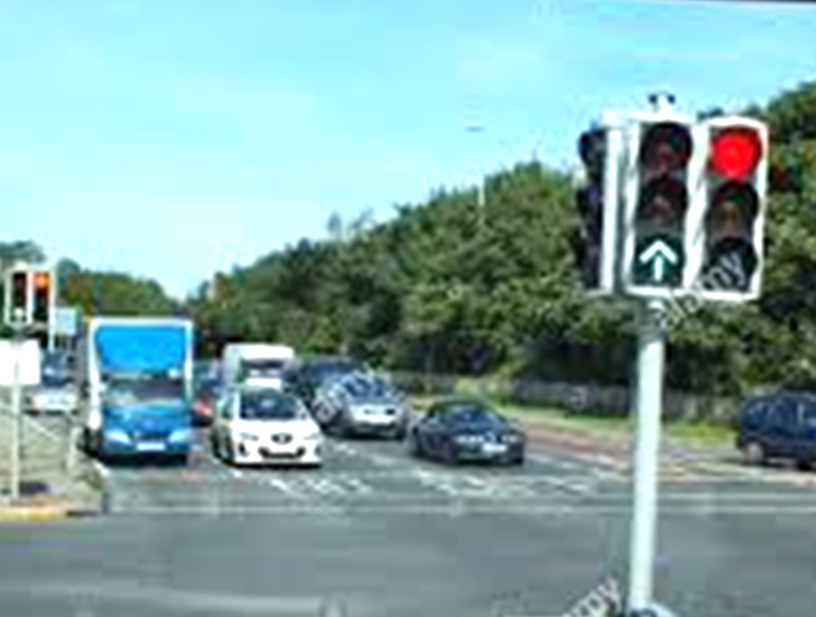

Slide 22
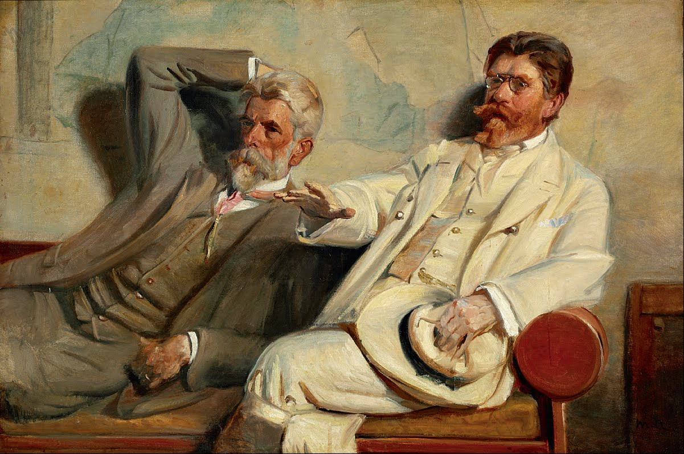

Slide 23
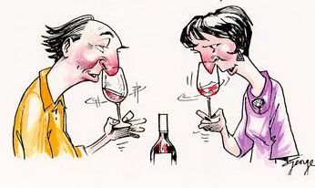

Slide 24





Slide 25
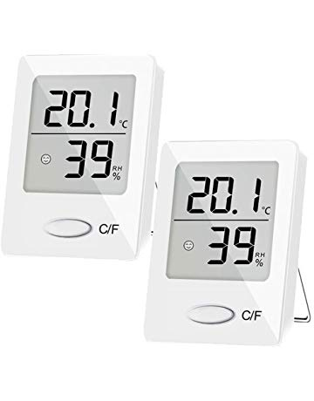

Slide 26
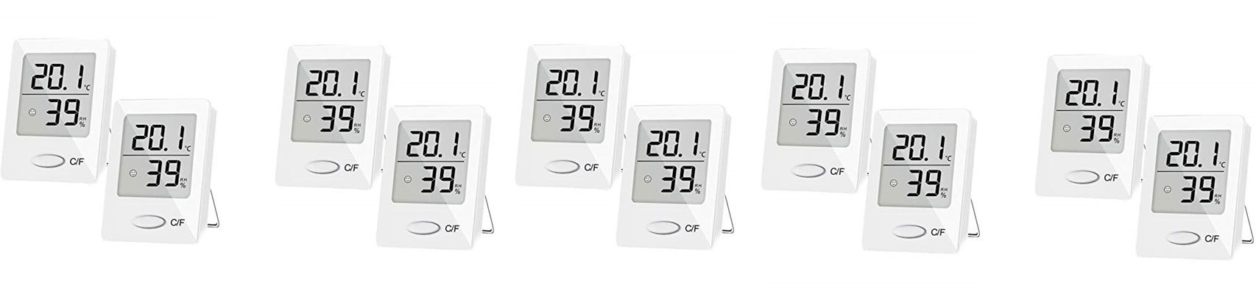

Slide 27
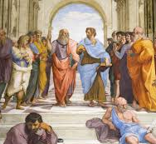
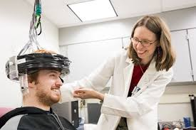
ü
❒
(end of part 2)

Slide 28
Part 3
Why is it that . . .?
It seems objectively unreasonable
Our mode of perception
and conscious activity generally confers an evolutionary advantage

Slide 29

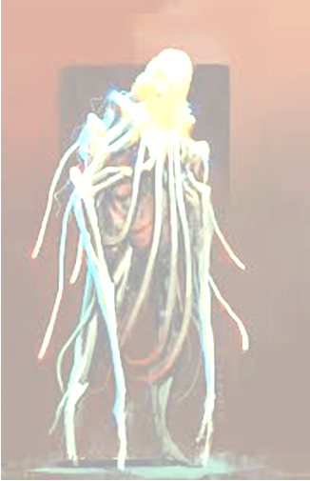
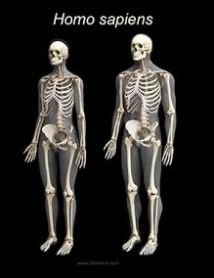
*******
[blimey!]

Slide 30
Why?
How come?
?
?
What for?

Slide 31
Parental DNA
Yes
Same?
Fewer
Offspring
No
No
Offspring DNA
Better?
More
Offspring
Yes

Slide 32
Whenever x, do y
Neural network
Whenever x, do y again
Unconscious processing and response

Slide 33
Selected focus
on
Edited version

Slide 34
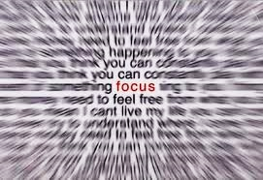

Slide 35
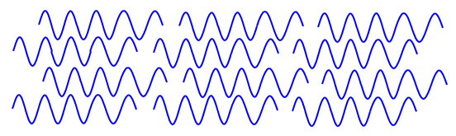

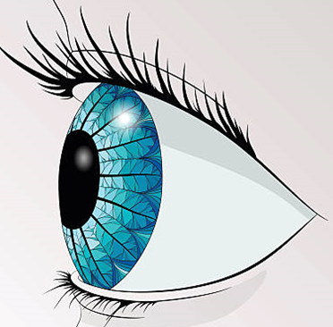


Slide 36
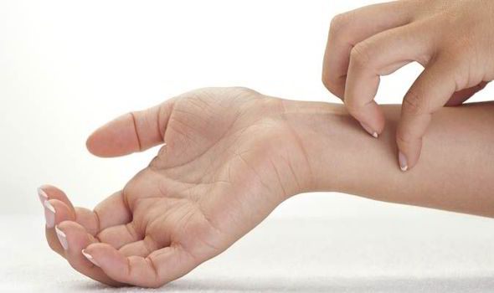

Slide 37
take this sequence of precisely one hundred characters and using only the english alphabet and space

Slide 38
take this sequence of precisely one hundred characters and using only the english alphabet and space
Ignoring case and punctuation,
27 options per place

Slide 39
136,891,479,058,588,
000,000,000,000,000,
000,000,000,000,000,
000,000,000,000,000,
000,000,000,000,000,000,000,000,000,000,000,000,000,000,000,000,000,000,000,000,000,000,000,000,000,000,000,000

Slide 40
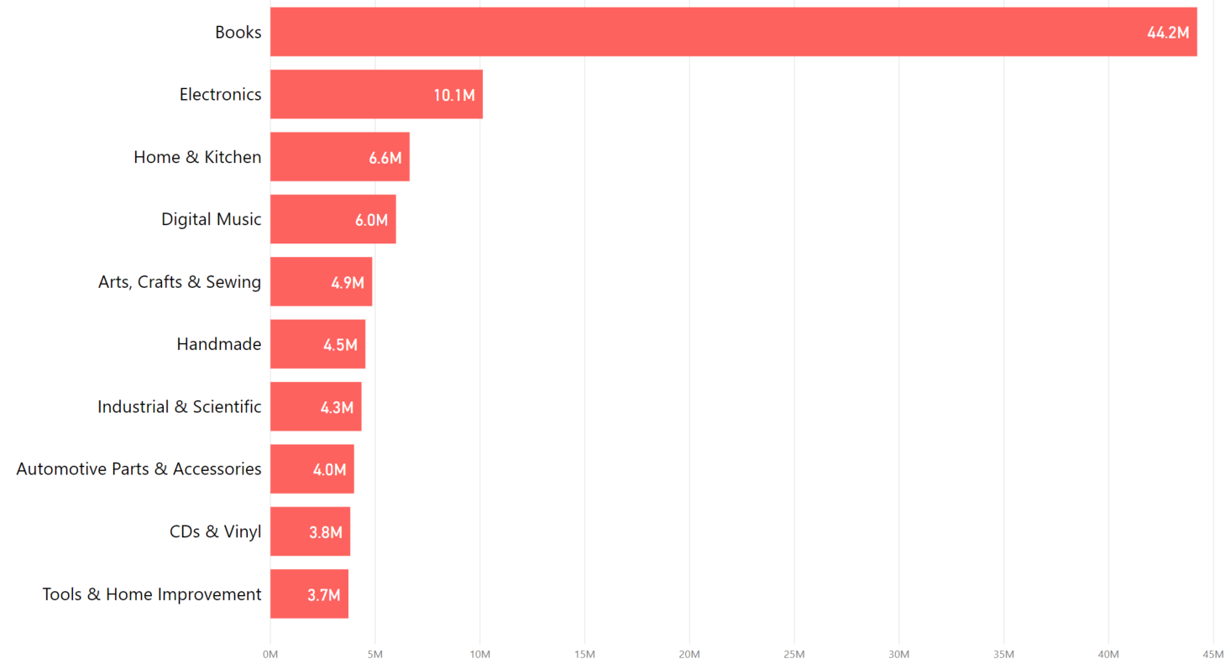
Books
44.2 million
Tools & DIY
3.7 million

Slide 41


Colour 
Insurance
Packaging 
Shape 
Weight 
In time ü
Last time?ü
Priceü
Shareable?ü

Slide 42

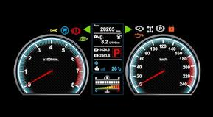
User Interfaces

Slide 43
Conscious processing and response
Consider factors a,b,c
and plans p, q, r
And this time . . .
Whenever x, do y
Neural network
Whenever x, do y again
Unconscious processing and response

Slide 44
Consciousness -
Marvel not Mystery

Slide 45
Consciousness the hard problem i.e?

Slide 46
Conscious processing and response
Consider factors a,b,c
and plans p, q, r
And this time . . .
Habit
Whenever x, do y
Neural network
Whenever x, do y again
Unconscious processing and response

