Slide 1
Quanta and Qualia
Alan Bailey
August 2019

Slide 2
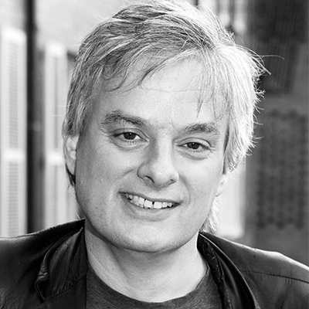
The Hard Problem
“It is widely agreed that experience arises from a physical basis….It is not easy to see how it [consciousness] could be part of the physical world. So it seems that to find a place for consciousness within the natural order, we must either revise our conception of consciousness, or revise our conception of nature.”

Slide 3
Every Thing Must Go
‘Individual objects, events and properties [are merely] devices used by observers… to keep cognitive books on what science finds to be sufficiently stable to be worth measuring over time….The main ontological implication…is that reality is not a sum of concrete particulars…. To put matters as simply and crudely as possible, it’s real patterns all the way down.’
Ref: Ladyman and Ross
‘In the world described by quantum mechanics there is no reality except in the relations between physical systems. It isn’t things that enter into relations but, rather, relations that ground the notion of ‘thing’. The world of quantum mechanics is not a world of objects: it is a world of events. Things are built by the happening of elementary events….The world of existent things is reduced to a realm of possible interactions’.
Ref: Carlo Rovelli - ‘Reality Is Not What It Seems’

Slide 4
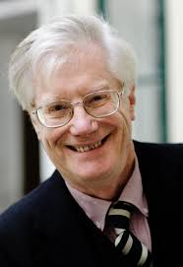
The Knowledge Argument
Mary knows all the facts about the perception of colour which can in principle be expressed in the vocabulary of physical science.
Unlike those who have normal visual experiences, Mary does not know what it is like to perceive colour.
Therefore…
What it is like to perceive colour cannot be characterised using the vocabulary of physical science.
The nature of any physical thing, state or property can be expressed in the vocabulary of physical science.
Therefore…
What it is like to perceive colour is not a physical thing, state or property.

Slide 5
Scientism
‘People who wish to explore the ways in which the…intuitive anthropological conceptual space is structured are invited to explore social phenomenology.
We, however, are interested in objective truth rather than philosophical anthropology.
Introspective anthropology is done all the time. Its expert practitioners are mainly writers of fiction. We do not recommend turning their job over to philosophers’.
Ref: Ladyman and Ross

Slide 6

Radical Empiricism
Avoiding “anomalous monism”
“entities are not to be multiplied beyond necessity”

