Slide 1
The Conscious Mind
Correlation, Causation, Identity, Supervenience, Emergence, Magic . . .

Slide 2
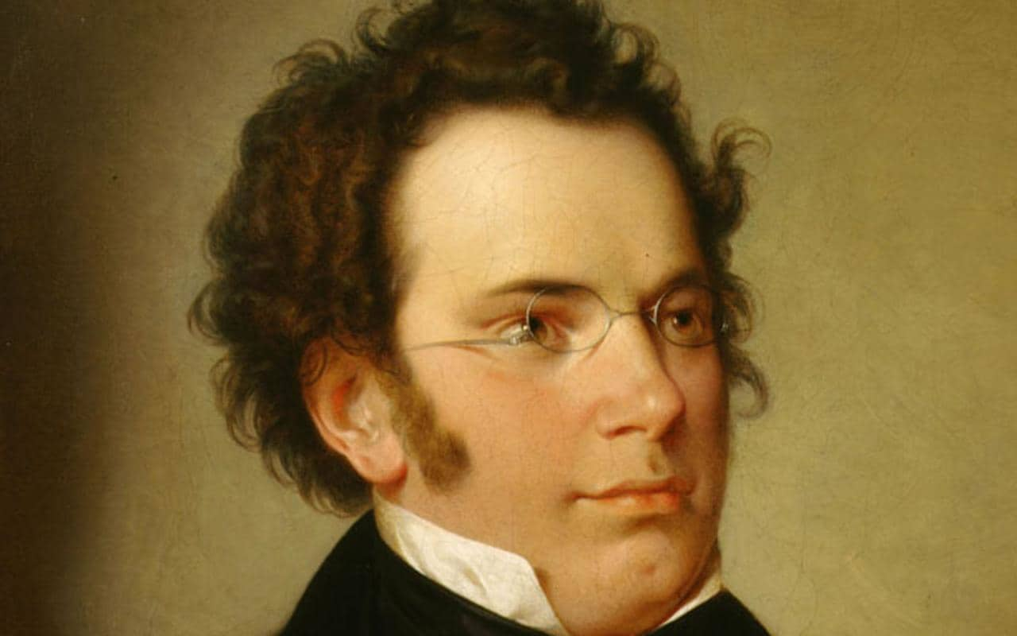

Franz Schubert

Slide 3
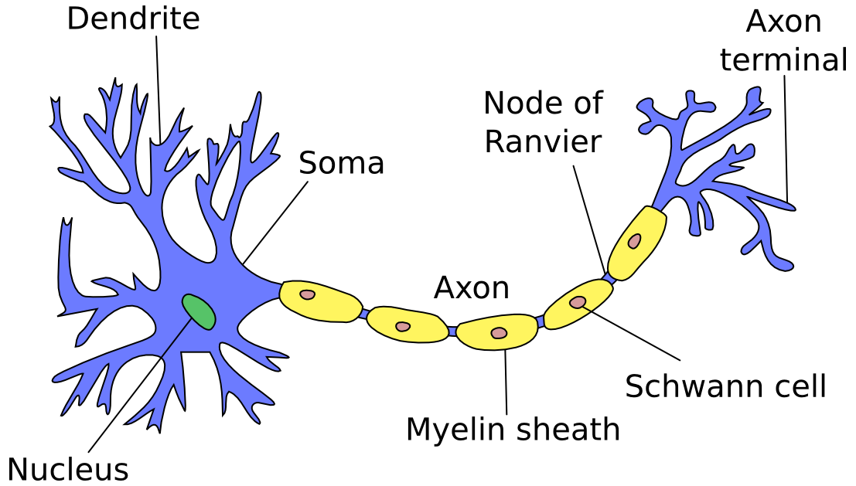
Just 1 of 86,000,000,000

Slide 4
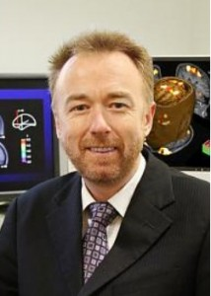
Prof Adrian Owen

Slide 5
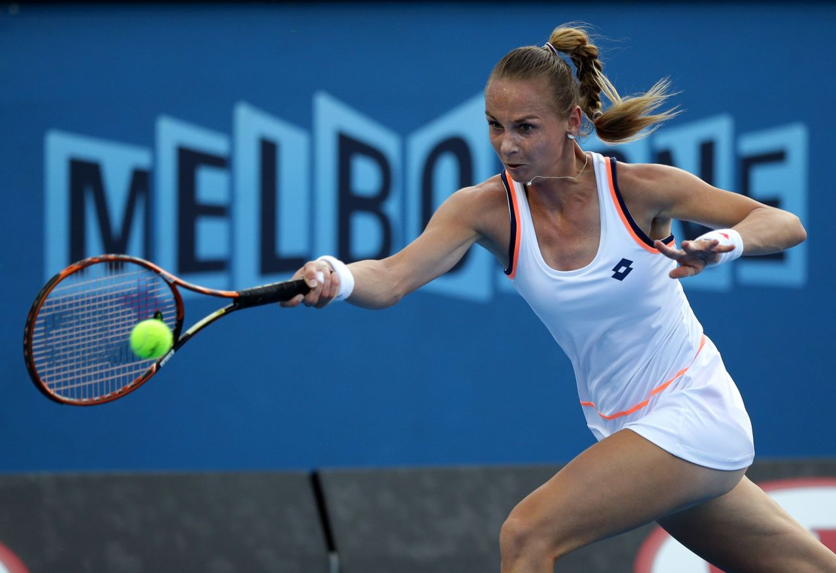
A species of hand-waving

Slide 6
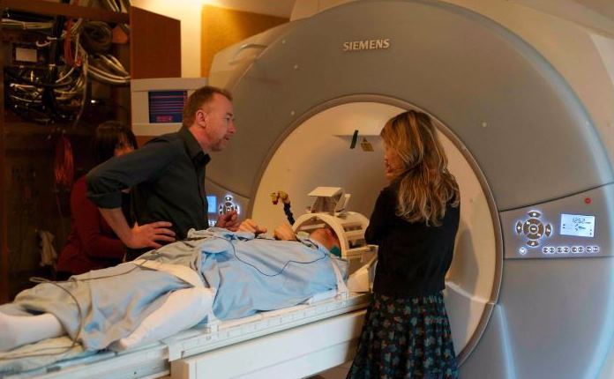
Prof Owen and a patient

Slide 7
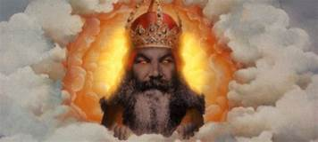
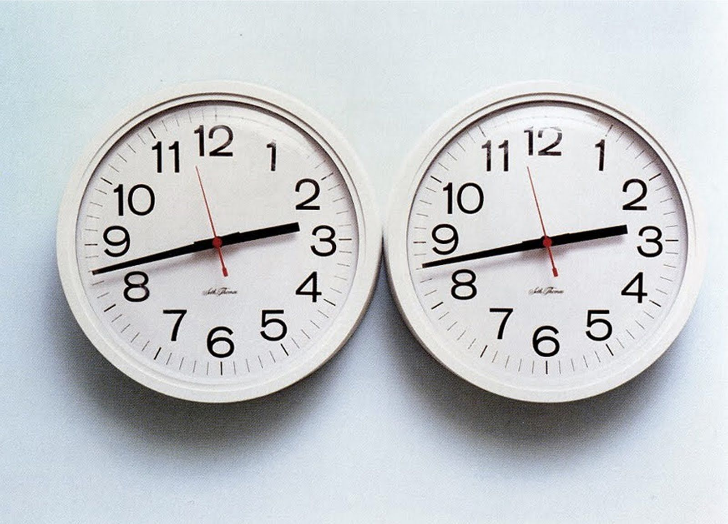
God coordinating physical events and conscious experiences

Slide 9
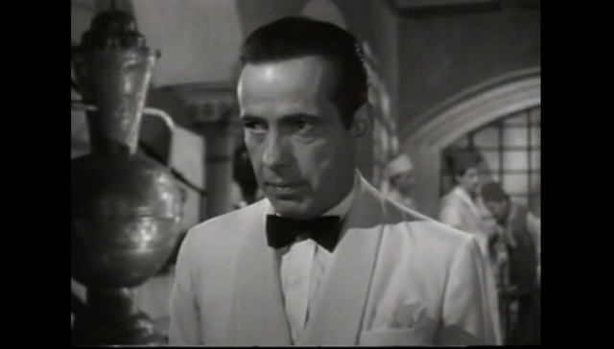
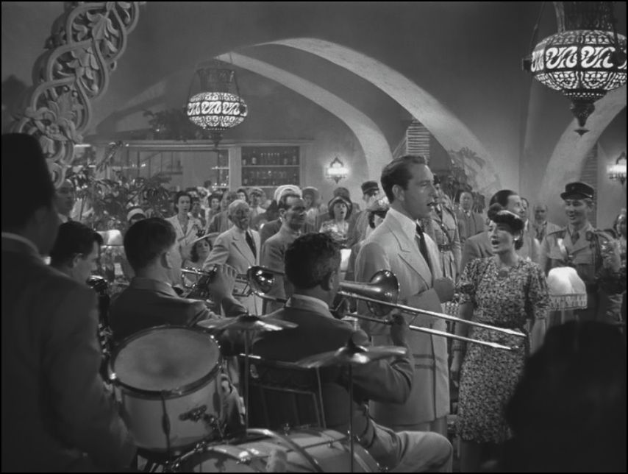

Slide 10
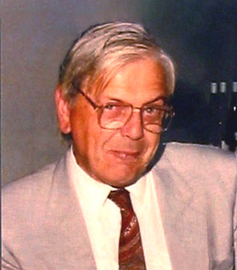
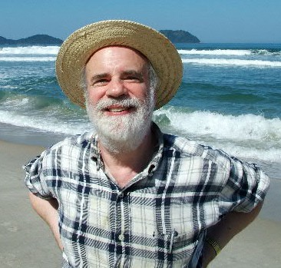
U.T.Place Saul Kripke

Slide 11

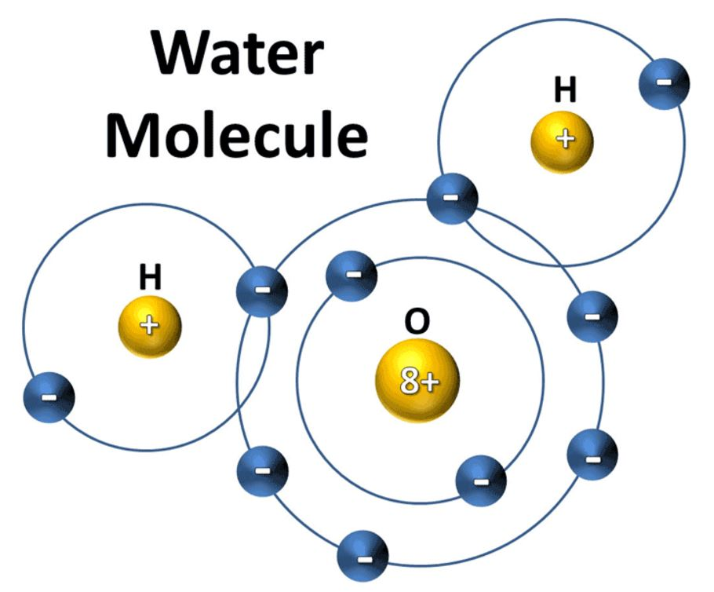
Water = H₂0

Slide 12
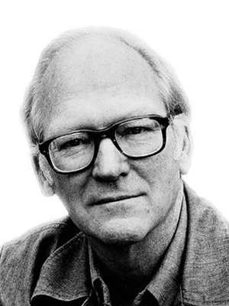
Donald Davidson: token identity

Slide 13
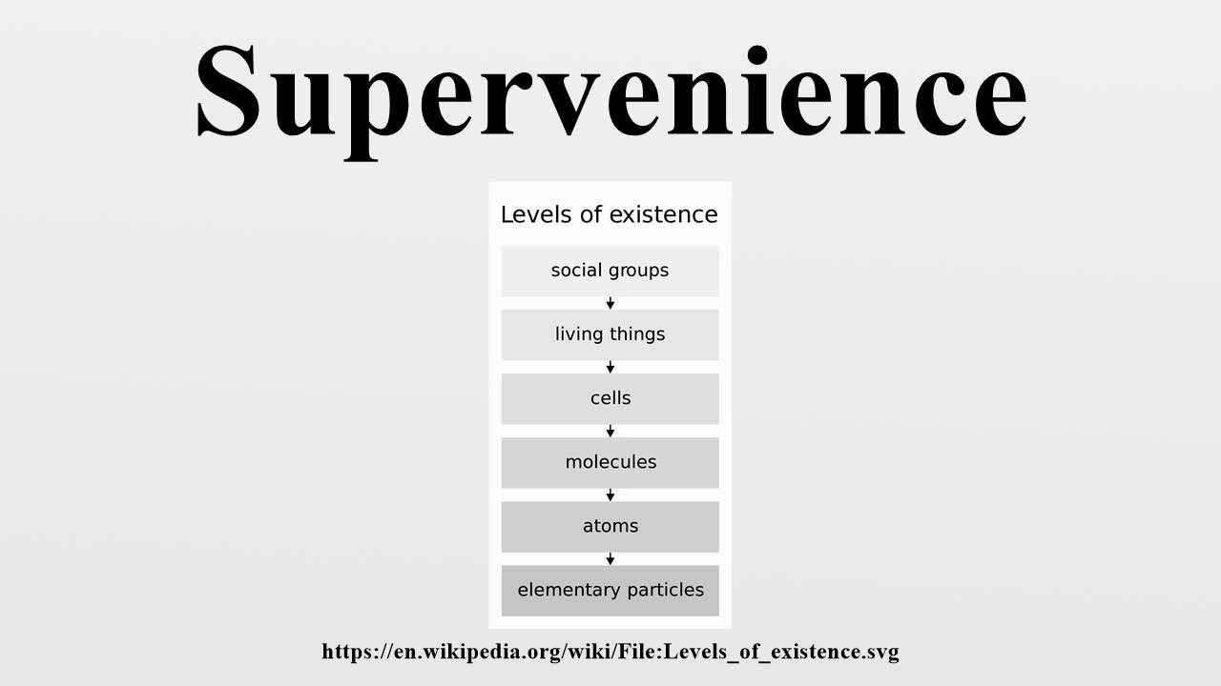

Slide 14

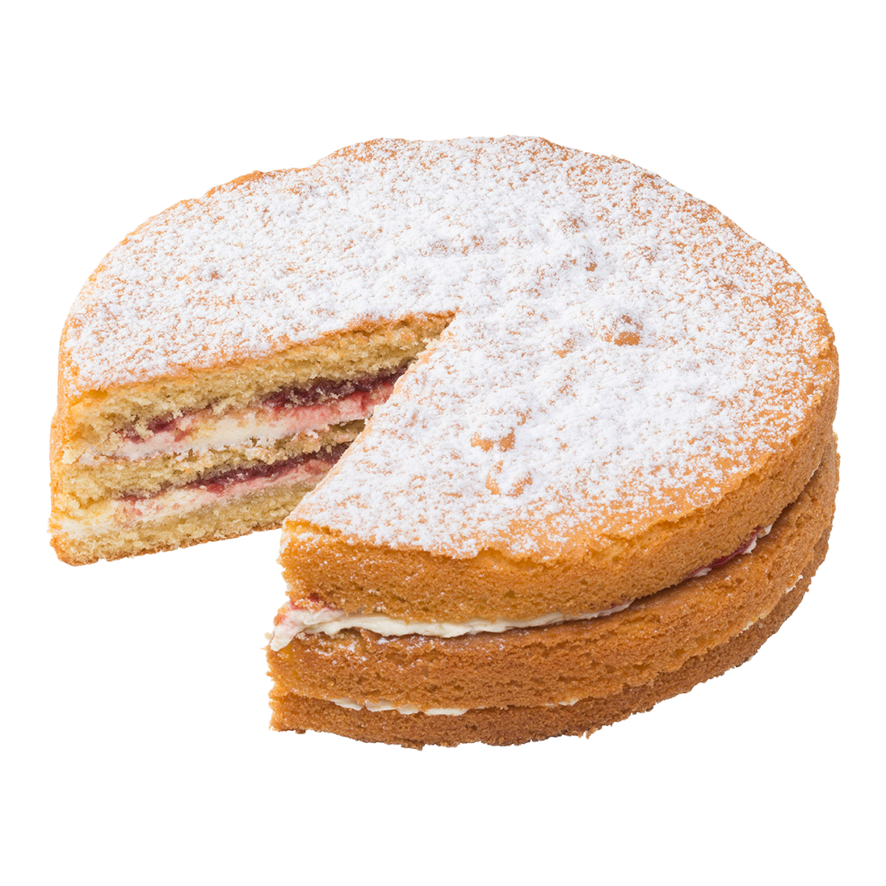
nb

Slide 15
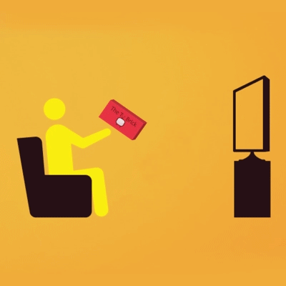
“The TV Brick”

Slide 16

Trying hard to follow the sun?

Slide 17
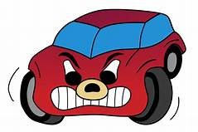
No, I won’t start!

Slide 19
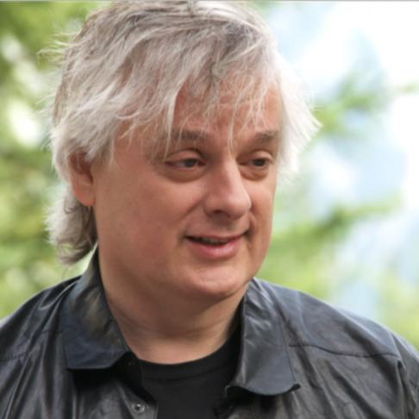
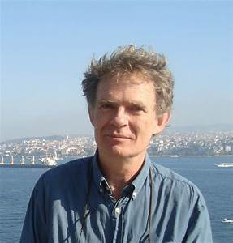
David Chalmers Galen Strawson

Slide 20


Slide 21
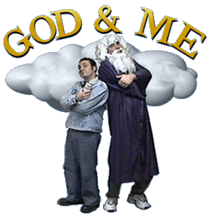
The only 2 conscious people in the universe?

Slide 22
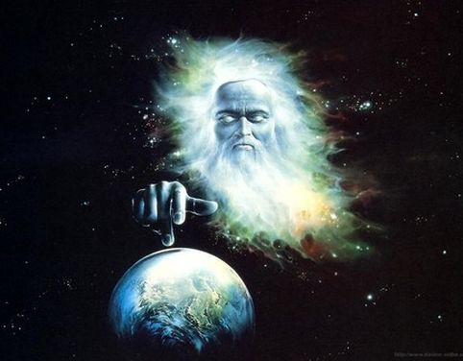

Slide 23

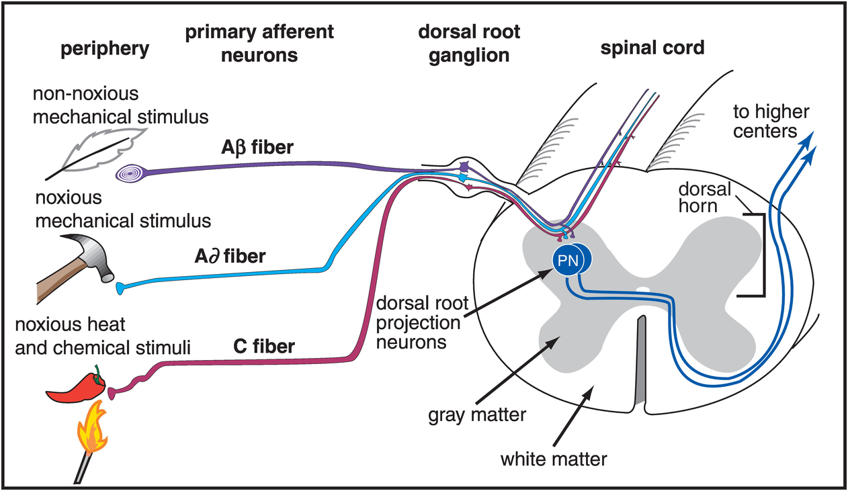

Slide 24
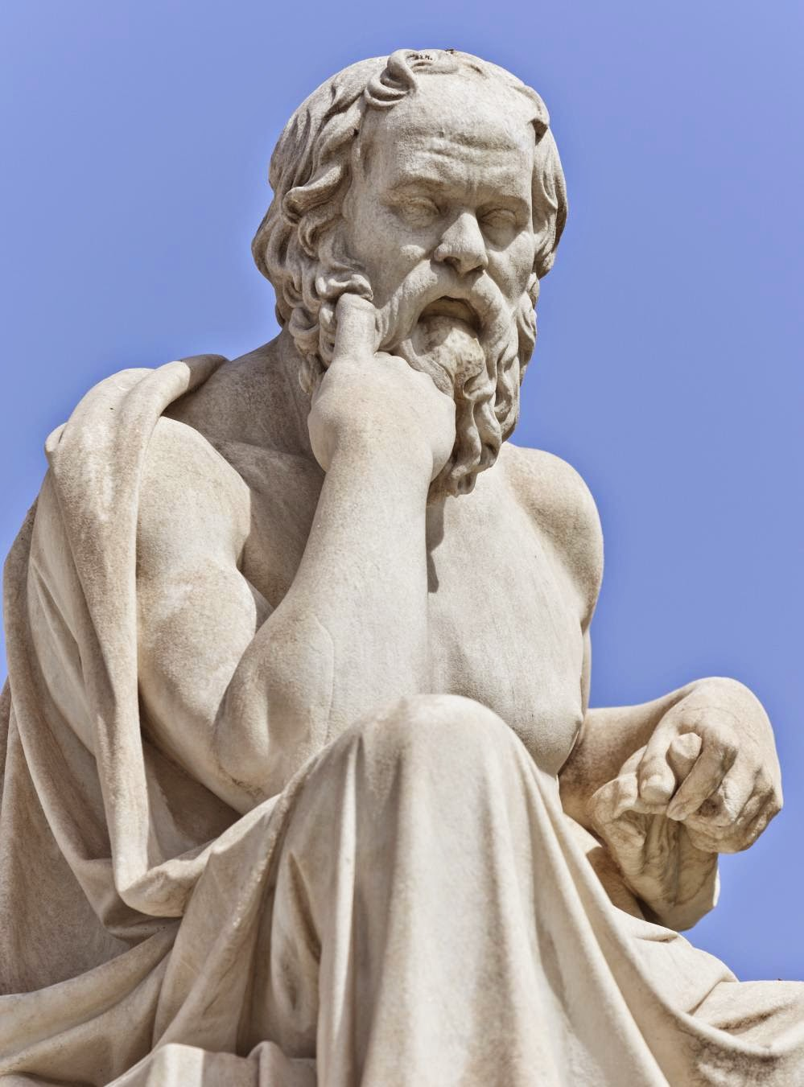
Socrates: the face of aporia

