Slide 1
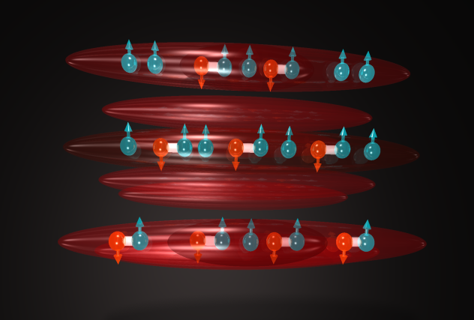
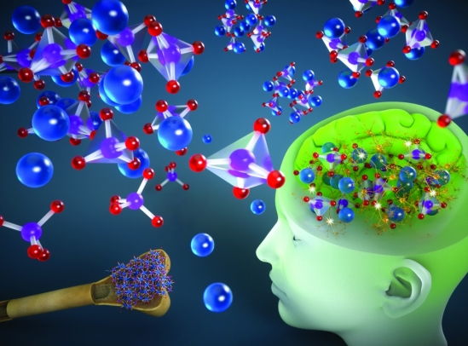
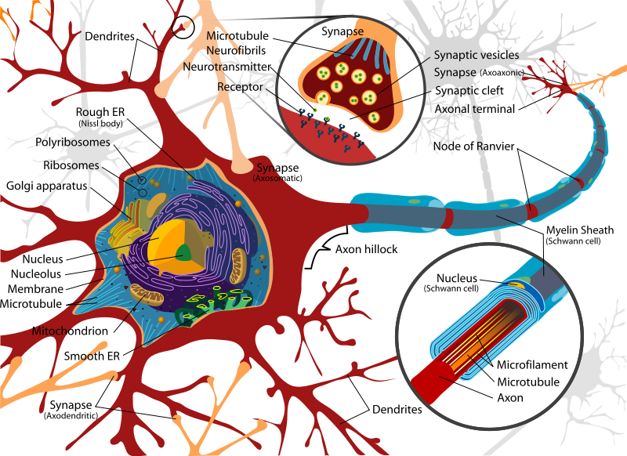
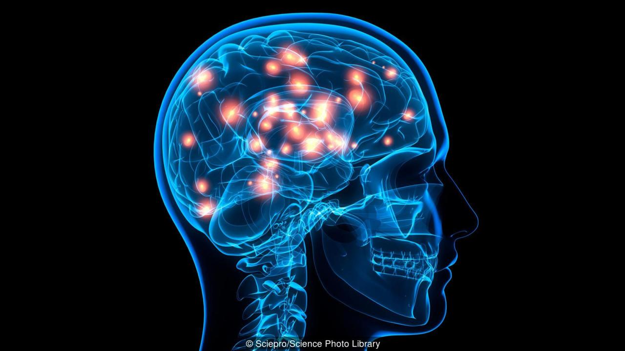
Quantum Mechanics, Neuroscience and Emergence
Kanan Purkayastha

Slide 2
Delimitation
I am not an expert talking in front of way about the subject matter, rather this is my personal journey of exploring the subject matter- “consciousness=subjective experience”;
My journey today is not spiritual one, rather through the landscape of the Cognitive Neuroscience and Quantum Mechanics;
My journey is ongoing.

Slide 3
Content
Consciousness and emergence
Neuroscience
Qubit and QBism
Field
Concluding remarks
  Propose a hypothesis
  Identify some challenges

Slide 4
Consciousness
Five ways of defining consciousness:
Awareness: An entity is conscious if it reacts to stimuli in the world.
Self awareness: An entity is conscious if it reacts to and can tell others about changes in itself.
Goal oriented behaviour: An entity is conscious if it takes intentional action to achieve goals.
Integrated information: An entity is conscious if it integrates many kind of information.
Experience: An entity is conscious if there is something ‘it is like’ to be that entity.
“Awareness” and its self-reflective variant “consciousness” are not static entities but ongoing processes (Torey ,2014)

Slide 5
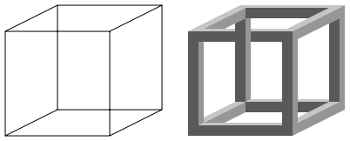
Necker cube
Is consciousness really just a story that our brain tells about the sensory input it receives through the body’s interaction with the world?

Slide 6


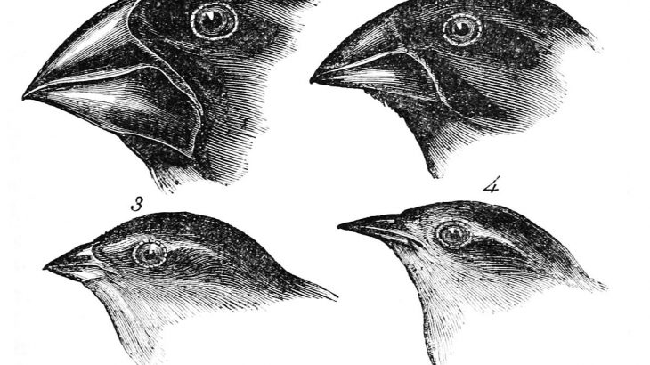
Hard or soft?
Bird’s eye view
Frog’s eye view
Gene’s eye view

Slide 7
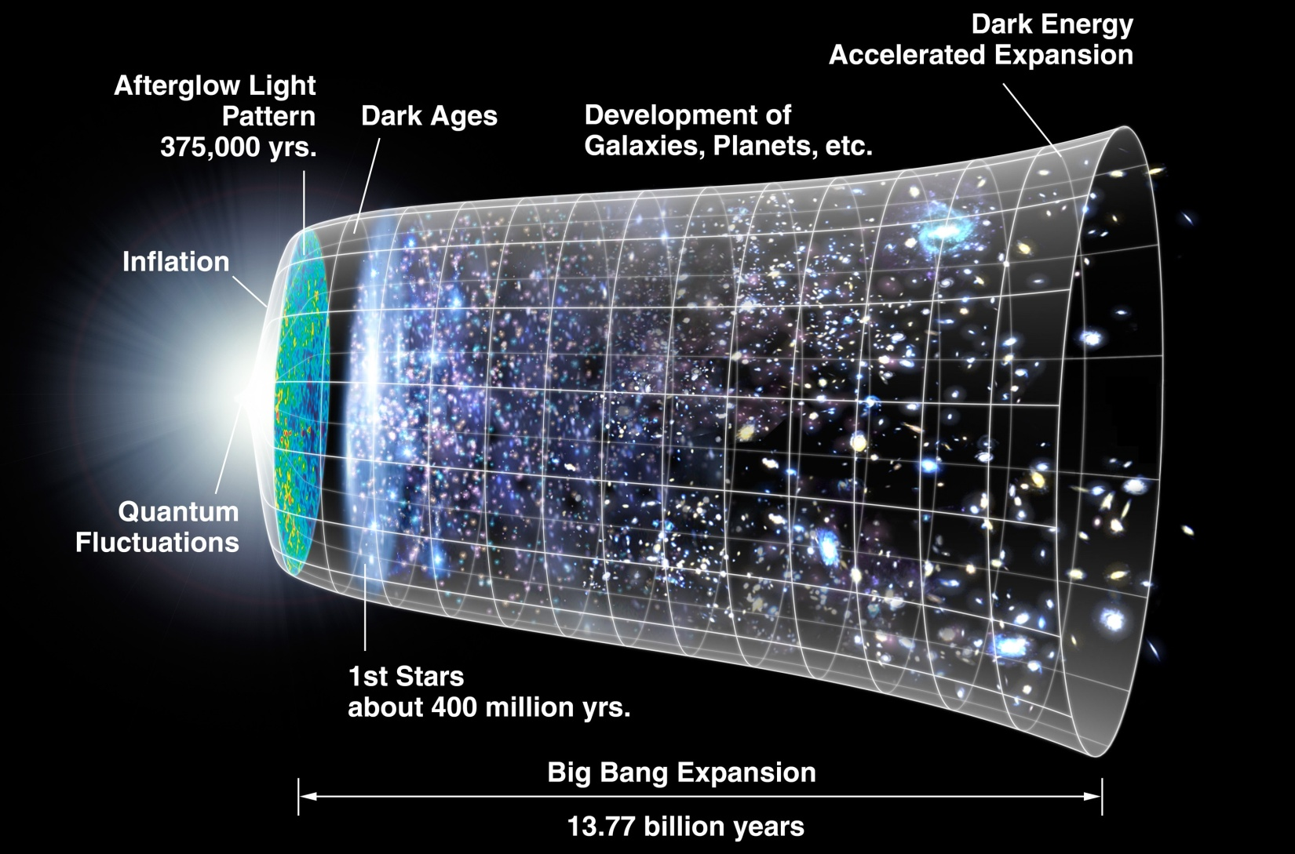
From the big bang to the big brain

Slide 8
Emergence
Consciousness as an emergent property;
Seven ways of looking at emergent property-
  Virginia Woolf (Art)
  Darwin, Haeckel and others (Evolutionary Biology)
  Penrose (Quantum cosmology)
  Lawrence Krauss (Nuclear physics)
  David Eagleman (Neuroscience)
  Francis Crick (Chemistry)
  Wheeler-Dewitt (Quantum physics)

Slide 9
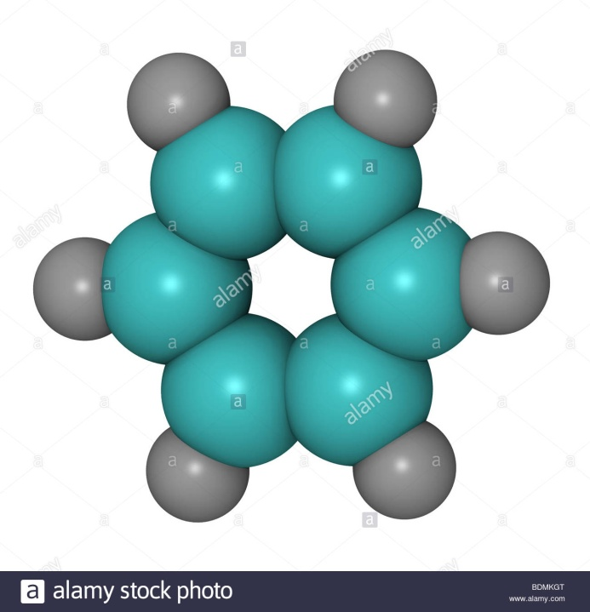
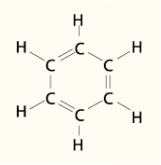
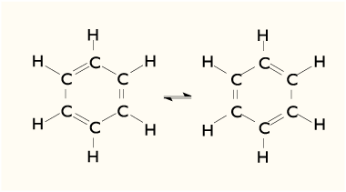
Francis Crick
Benzene
C+C+C+C+C+C+H+H+H+H+H+H =Liquid Compound (known as Benzene)
Benzene molecule is more than the some of its parts

Slide 10
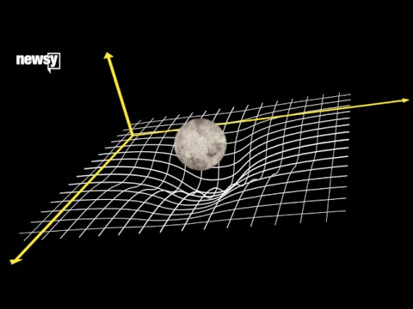
Wheeler-Dewitt
Quantum experiment shows how time ‘Emerges’ from entanglement like gravity emerge from space-time curvature;
Source: Newsy

Slide 11



Consciousness as Wave (Wave⇒QF)

Slide 12
Neuroscience

Slide 13
Three ways
From Experiment to Theory
  e.g NCC developed by Crick and Koch
From Theory to Experiment
  e.g Global Workspace Model developed by Dehaene, Barnard Baars and others;
  Daniel Dennett’s Multiple Drafts Theory
  Giulio Tononi’s Integrated Information Theory

Slide 14
Three ways(cont…)
Investigate consciousness as a variable
  The challenge is to understand the relations between the mental properties of being conscious and the physical properties of brains, where both physiology (the objective perspective) and phenomenology (subjectivity) are given equal weight and constantly cross-referenced against each other;
  Libet’s experiment;
  Employ different technologies such as MEG, fMRI, TMS

Slide 15
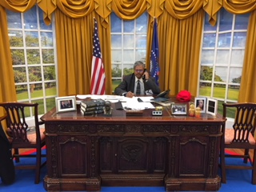
Seeing is not believing but a potential stimuli

Slide 16
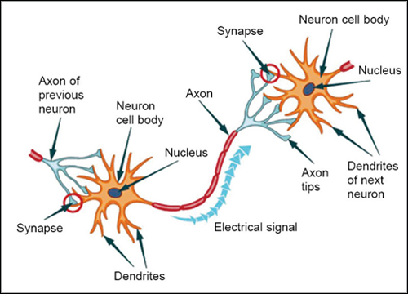
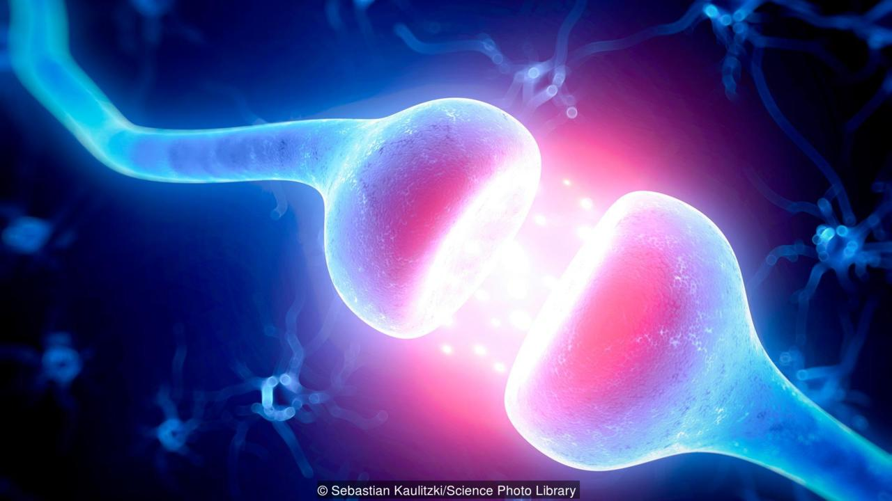
Neuron
A neuron is a cell that carries electrical impulses.
Every neuron is made of a cell body, dendrites and an axon. There are about 86 billion neurons in the human brain, which comprises roughly 10% of all brain cells. Rest is made of glial cells. They build the myelin sheath that regulates the transmission of action potentials through axon.
Neurons are connected by tiny gaps called synapses. Here neurotransmitter relay, amplify and modulate signals between neurons and other cells.
Source: BBC (2017)

Slide 17
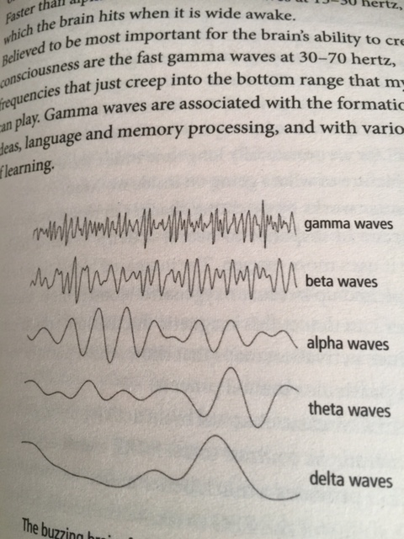
Brain activity: EEG result
Delta waves1-4 hertz: deep, unconscious, dreamless sleep;
Theta waves 4-8 hertz: light sleep or meditation;
Alpha waves 8-12 hertz: synchronised activity: observed during relaxed wakefulness;
Beta wave 13-30 hertz: brain hits when it is wide awake;
Gamma waves at 30-70 hertz creates consciousness. Gamma waves are associated with the formation of ideas, language and memory processing and various types of learning
Source: du Sautoy, (2016)

Slide 18
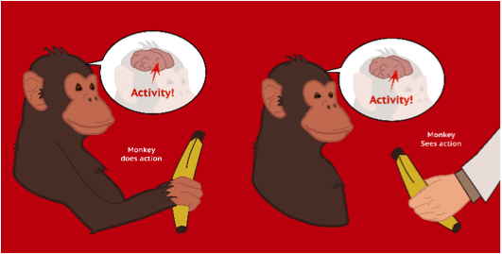
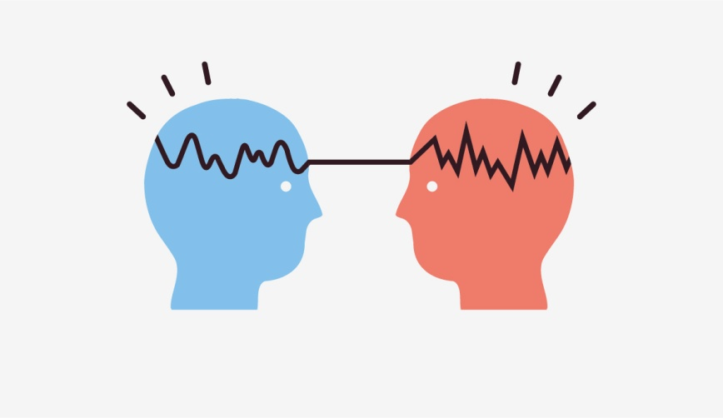
Theory of Mirror Neuron
University of Parma research;
A class of neurons that fire both when an individual performs an action and when the individual observes the same action performed by someone else;
Loops exist between brains. The same thought and feeling can arise in different minds, with invisible networks filling the space between them.
Source: https://www.researchitaly.it/en/success-stories/cnr-and-university-of-parma-a-new-research-unit-to-study-mirror-neurons/

Slide 19

A challenge
Connectome: Precise map of neural connections;
86 billion neurons’ connection need to be explored. So far 302 connections we understood;
  Nematode Caenorhabditis elegans
  Connections differ in strength;
  Genes influence neural connections;
  Modular brain: Nodes and module
  [Source: New Scientist, 6 July 2019; Nature, DOI: 10.1038/s41586-019-1352-7; Scientific American, July 2019)

Slide 20
Qubit and Qbism

Slide 21
Why Quantum mechanics ?
Quantum mechanics plays a role in the brain, since quantum mechanics determine the shapes and properties of molecules like neurotransmitters and proteins, and these molecules affect how the brain works.
E.g Influence of Morphine on the level of consciousness.

Slide 22


Impossibility is a holistic view, possibility is a localised view.
Possibility is a holistic view, impossibility is a localised view.
(Source: Phys.org, 2015)

Slide 23
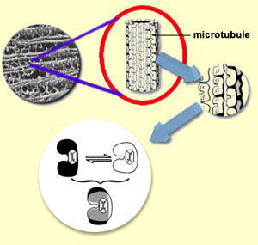
Quantum Brain: Penrose and Hameroff scheme
The brain’s neurons contain hollow cylindrical polymers called microtubules, which is made up of individual proteins known as tubulin;
Tubulin exist in a superposition of two slightly different shapes;
Coherent superposition is maintained for a significant time, allowing for preconscious processes to emerge;
Objective reduction (OR) of the superposition takes place when critical threshold is reached and consciousness is switched on.
Max Tegmark calculates quantum events in microtubules survive 10⁻¹³ s-10⁻²⁰ s

Slide 24
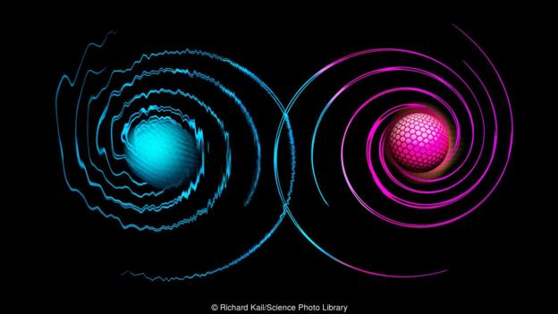
Nuclear spin quantum processing in brain
Research carried out by Fisher (2015) at University of California;
Observe the effect of Li-7(s=3/2) and Li-6(s=1/2) on Rat. Li-6 stimulate more than Li-7;
Li-7, t_{coh~10s} < Li-6, t_{coh ~ 5 min}
Identify P only biochemical element with s=1/2;
Personal communication with Fisher;

Slide 25
Spin (cont…)
Magnetic and electric field perturbation cause quantum decoherence of the nuclear spin;
Coherence time (t_{coh}) must be maximised;
Enzyme catalyzed chemical reaction which breaks the pyrophosphate ion into two phosphate ions can quantum entangle pairs of qubits;
The presence of bone mineral calcium phosphate molecule, known as Posner molecule Ca₉ (PO₄)₆ available in body fluid increase the coherence time.

Slide 26
Quantum Bayesianism(QBism)
Christopher Fuchs, Carlton Caves and Rudiger Schack, Physicists and Mathematician developed the idea;
Wave function encodes the probabilities for the outcomes of any measurements an observer might perform on it;
Interpret the wave function’s probabilities as Bayesian probabilities;
Wave function does not describe the world-it describes the observer;
Quantum mechanics is a law of thought;
Quantum probability is subject dependent.

Slide 27
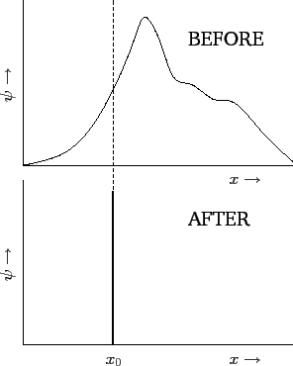
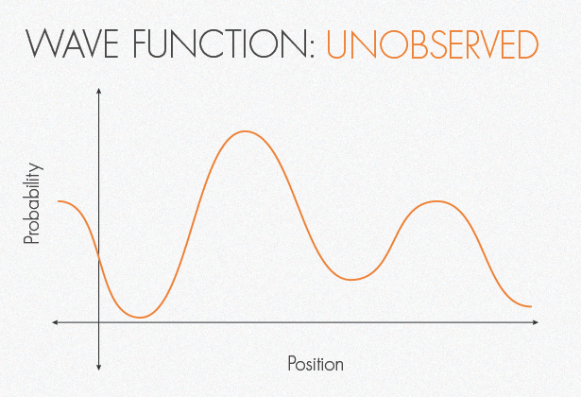
QBism(cont…)
According to QBism, the wave function’s ‘collapse’ is simply the observer updating his or her beliefs after making a measurement.

Slide 28
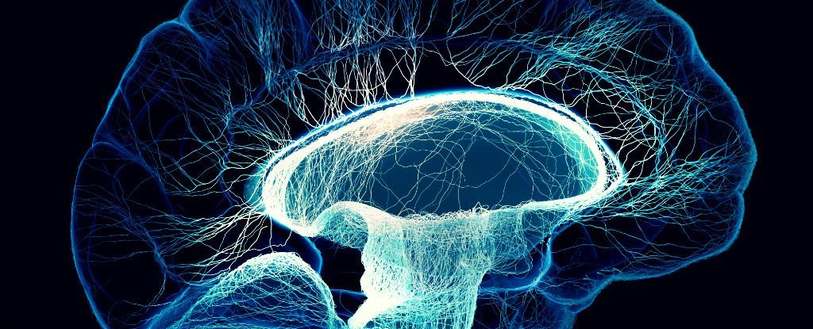
Idea of field
A simple scheme
Brain’s EM energy field
Neuron

Slide 29
Concluding remarks
Every part of our body is in connection with every other part;
All living organisms continuously emit radiations of light that form a field of coherence and communication (biophoton);
Perhaps consciousness arises when the brain’s simulation of the world becomes so complete that it must includes a model of itself;

Slide 30
Concluding remarks(cont…)
Nuclear spin dynamics can explain the consciousness processing in the brain. The spin dynamics is not independent of other part of the body. A new discipline of quantum neuroscience need to explore this matter further;
The concept of entropy can be utilised for the neural connection modelling and interpretation;
QBism can contribute to the interpretation of subjective consciousness;

Slide 31
Concluding remarks (cont…)
Some aspect of consciousness such as loss of consciousness can be explained by Tononi’s (ϕ) approach of IIT;
Theory of mirror neuron can explain some aspects of consciousness. Quantum entanglement and quantum tunnelling can explain the binding mechanism for it;

Slide 32
Concluding remarks (cont..)
Unconscious can spill over into conscious thoughts. Also conscious mind steps in only after unconscious processing has taken place. So, we need to understand more about the unconscious state of the brain, our silent thinking partner.
Is reality intrinsically random or fundamentally interconnected? I argue that it is interconnected. I agree with Philosopher Heidegger that self doesn’t exist in a vacuum.

Slide 33
Concluding remarks (cont..)
Hence, my hypothesis is-
  Consciousness, a self reflective variant of awareness, emerge from the interaction of neurons and their electrical and chemical impulse governed by quantum spin dynamics. It emerges like a wave emerge in a lake. The wave manifest itself as a field. The field can interact with other fields that generate from the whole system through quantum wave resonance and an effector is needed for it’s manifestation.

Slide 34
Concluding remarks (cont…)
However, I am aware of some challenges:
  Defining consciousness. What to look for if we go inside a brain?
  In order to understand ‘what it is like’ require a predictive model, which is based on all possible connections between 86 billion neurons. Counting 1 neuron per second will take approximately 2700 years. Each neuron is connected to 10000 other neurons. If we count one connection every second it would take three million years to complete the task. Our progress to date is 302 connections;

Slide 35
Concluding remarks (cont…)
Estimates of the human brain’s memory capacity vary widely from 1 to 1000 terabytes. For comparison the 19 million volumes in the US Library of Congress represents about 10 terabytes of data. So, physiology of (objective perspective) brain is intrinsically subjective;
There is a conceptual gap between science, which stands for objective measurement and the conclusion we can draw thereby, and consciousness, which is a synonym for subjective experience;

Slide 36
Scientifically speaking!
Why is anything conscious?
How do physical properties determine qualia?
How does the brain process information?
What physical properties distinguish conscious and unconscious system?
Really hard
Theories untestable
Even harder
Theories partially testable?
Pretty hard
Theories testable with brain reading
Easy
Theories testable by simulation

Slide 37
Concluding remarks (cont…)
Therefore, how the ‘water’ of objective brain events is transformed into the ‘wine’ of subjective consciousness is a question, that will remain unanswered for a pretty long time.

Slide 38
References
Crick, F (1994), The Astonishing Hypothesis, Touchstone Books, London
Caves, C.M, Fuchs, C.A and Schack, R (2001), Quantum probabilities as Bayesian probabilities (arXiv:quant-ph/0106133v2)
David, A (2019), The Secret Life of the Brain, Cassell, London
Du Sautoy, M (2016), What We Cannot Know, Fourth Estate, London.
Eagleman, D (2015), The Brain: The Story of You, Canongate, London
Fisher, M, P, A (2015), Quantum cognition: The possibility of processing with nuclear spins in the brain (https://arxiv.org/abs/1508.05929)
Greenfield, S (2017), A Day in the Life of the Brain, Penguin Books, London
http://www.bbc.com/earth/story/20170215-the-strange-link-between-the-human-mind-and-quantum-physics
Kaworski, W (2011), Philosophy of Mind, Wiley-Blackwell, United Kingdom
Magrini, M (2019), The Brain: A User’s Manual, Short Books, London
New Scientist (2017), Your Conscious Mind, John Murray, UK
New Scientist (2017), The Quantum World, John Murray, UK
Passingham, R (2016) Cognitive Neuroscience, Oxford University Press, Oxford
Stanford Encyclopedia of Philosophy, Quantum Approaches to Consciousness (revised in 2015) access at https://stanford.library.sydney.au on 16 June 2019)
Tegmark, M (1999), The importance of quantum decoherance in brain processes (arxiv:quant-ph/9907009v2)
Tononi, G and Edelman, G (2000), Consciousness: How Matter Becomes Imagination, Penguin Books, London

Slide 39

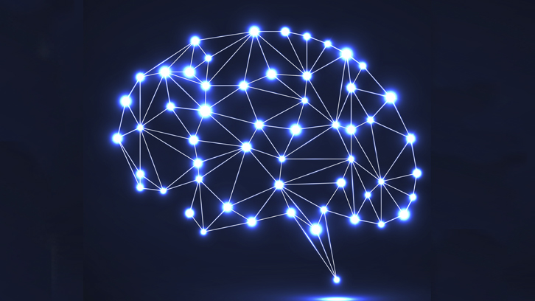


Thank you for listening…
My sweet brain!!
My sweet heart!!

