Slide 1
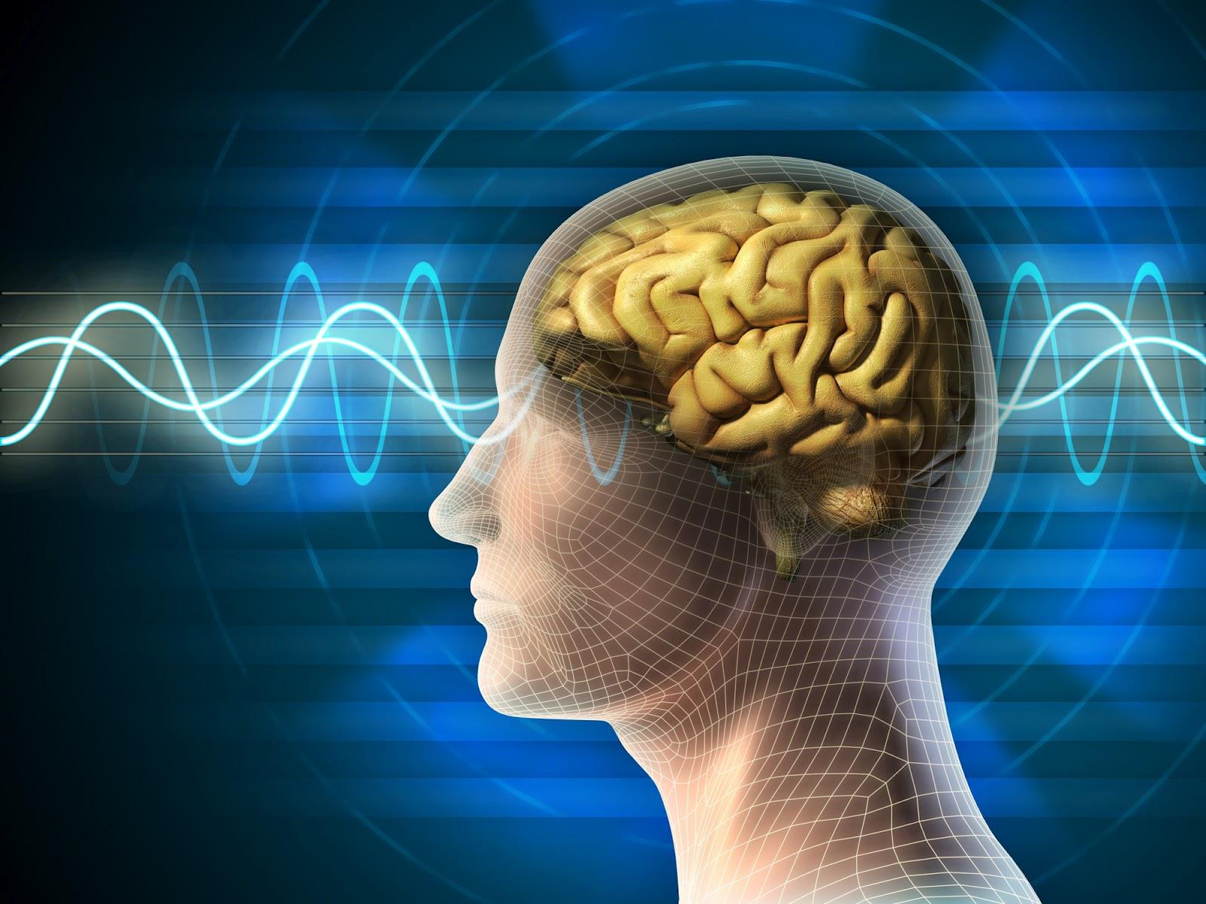
The Hard Problem of Consciousness
The Philosophical Society - Members’ Weekend, 2019

Slide 2
Introduction to the Hard Problem
Tim Bollands
2

Slide 3
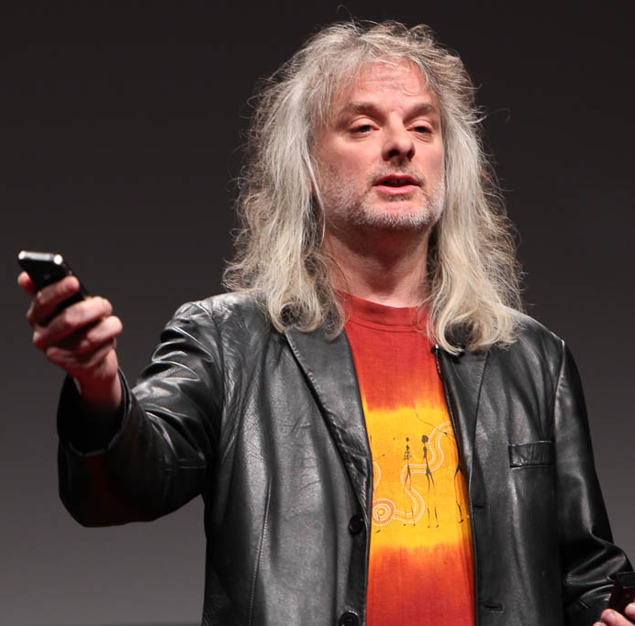
Why the ‘Hard Problem’?
“Easy” Problems
Understanding :
how our brains respond to stimuli
how our brains report on our mental states
how our brains control our body’s behaviour
how our brains …. perform any function
The “Hard Problem”
Understanding :
how and why such functioning is accompanied by a subjective phenomenal experience

Slide 4
The Most Exciting Problem in Philosophy !
Crosses the boundary between Philosophy and Science
A real opportunity for philosophers to make a valuable contribution to science
Easy to understand
Accessible to all
No one knows the answer !
There is an answer out there waiting to be found

Slide 5

‘The Mind-Body Problem’ vs ‘The Hard Problem’
BODY (MATTER)
?
MIND (SPIRIT)
Doesn’t it feel great to be here at the PhilSoc Members’ Weekend ?

Slide 6
‘The Mind-Body Problem’ vs ‘The Hard Problem’
MATTER
?
MIND
Beliefs
Likes / Dislikes
Desires
…
Behaviour
Speech
Propositional attitudes
Qualitative states
HOW?
HOW?
Brain states
?
Mental states
?
Sensory inputs
Sights
Sounds
Feelings
…
HOW?
Physical events
?
Mental events
WHY?
The Hard
Problem

Slide 7
As David Chalmers put it …
“Why is it that when our cognitive systems [process] visual or auditory information, we have visual or auditory experience - the quality of deep blue or the sensation of middle C? How can we explain why there is something it is like to entertain a mental image, or to experience an emotion?”
David Chalmers (1995), Facing Up to the Problem of Consciousness, Journal of Consciousness Studies
“It is widely agreed that experience arises from a physical basis, but we have no good explanation of why and how it so arises. Why should physical processing give rise to a rich inner life at all? It seems objectively unreasonable that it should, and yet it does”

Slide 8
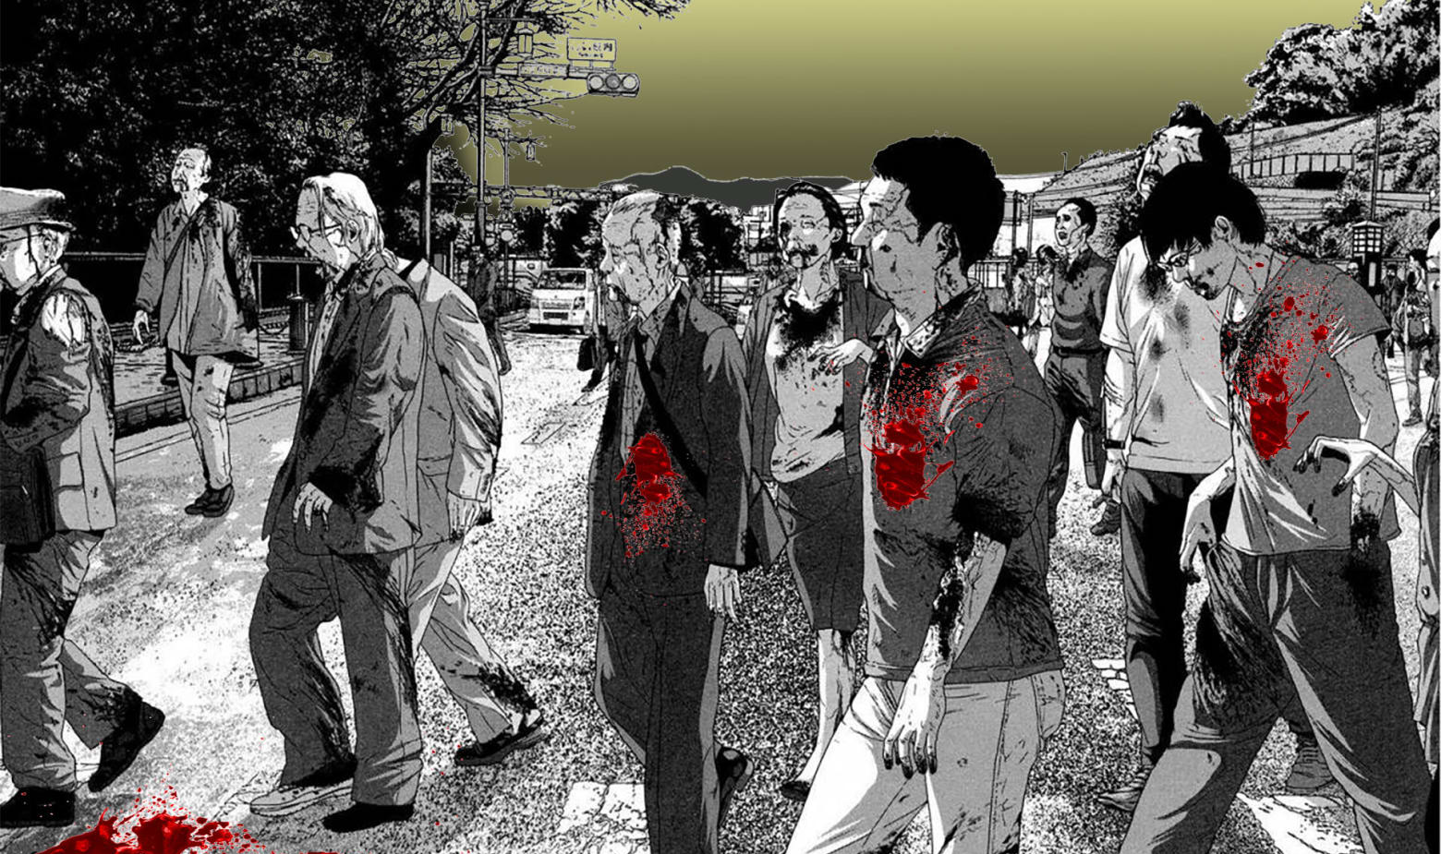
Why are we not zombies?

Slide 9

Why are we not zombies?

Slide 10
In Chalmers’ view…
“Consciousness fits uneasily into our conception of the natural world. On the most common conception of nature, the natural world is the physical world. But on the most common conception of consciousness, it is not easy to see how it could be part of the physical world. So, it seems that to find a place for consciousness within the natural order, we must either revise our conception of consciousness, or revise our conception of nature.”
David Chalmers (2002), Consciousness and its Place in Nature

Slide 11
PhilSoc Members’ Weekend, 2019
Saturday
1:55 A Hard Problem, but not that Hard – Mike Arnautov
2:45 Is this Human Real or Synthetic? – Paul Griffiths
4:00 Quantum Mechanics, Neuroscience & Emergence – Dr Kanan Purkayastha
4:50 Correlation, Causation and Identity – Bob Stone
5:45 “Quanta” and “Qualia” – Alan Bailey
Sunday
9:30 A Marvel, not a Mystery – Jonathan Harlow
10:15 Mind within Matter – Tim Bollands
11:30 Panel Discussion – all 7 speakers

Slide 12
THANK YOU
Insert Image

